Slide 1
Digital Maturity Assessment Detailed Assessment Report
Digital Strategy
FBNQuest
October 2018

Slide 2
Content
01
Background
02
Key Findings
03
Detailed Assessment
03
Appendix
Notes:
Change colours
Ecosystem scanning
CRM

Slide 3
Background
Notes:
Change colours
Ecosystem scanning
CRM

Slide 4

Background
Context & Objectives
Following the Group’s ambition of becoming the leading Merchant Bank and Asset Manager in Africa, FBNQuest has identified digital as a critical enabler for the realization of this ambition. Consequently, the Group has engaged KPMG, a global leader in digital strategy and transformation services, to provide the assistance required to drive the development of its digital strategy intended to reposition the Group within its target markets.
As part of the Assess phase of Digital Strategy Program, we have run a Digital Maturity Assessment (DMA) to prepare this report on FBNQuest’s current baseline / starting position for Digital.
The objective of the Digital Maturity Assessment is to obtain a diagnosis of how well positioned FBNQuest is to successfully navigate digital transformation journey and identify existing gaps by benchmarking its capabilities against those of its peers and global players in similar lines of business.
Initiate
Program Initiation
Assess
Digital Maturity Assessment
Strategize
Customer Propositions
Operating Model
Value Management
Technology Enablement
Risk Model
Co-creation Model
Plan
Digital
Transformation
Roadmap

Slide 5
Background
Digital Maturity Assessment Approach
The digital maturity assessment (DMA) for FBNQuest Group covered six (6) domains and twenty-one (21) sub-domains, as follows:
Relevant domains and sub-domains were identified for the Digital Maturity Assessment
For each domain and sub-domain, current state assessment and benchmarking were carried out utilising the following sources of information:
Calibrate FBNQuest’s current maturity relative to local & global benchmarks and the aspiration state
1
2
3
Digital Maturity Survey, Interviews
& Current State Documentation Review
Maturity Rating
A
Lagging
Behind the industry
Digital maturity assessment surveys were deployed, current-state documents were reviewed and relevant stakeholders were interviewed across FBNQuest business entities and enabling functions to elicit feedback on the current state with respect to the digital journey.
Basic
Fit for purpose
Progressed
Foundational capability in place to enable progression to leading state
Leading
Aligned to leading industry players
Innovating
Leading the leaders, experimenting with emerging capability
B
Relative Industry Comparison
Based on external insights from research and industry-knowledge, FBNQuest was benchmarked against local peers and global leaders in its line of business. Consequently, the bank’s aspirational state was defined based on input from the benchmarking as well as the inferred target state per the DMA survey.

Slide 6
Background
1
Digital Maturity Assessment Scope
The digital maturity assessment for FBNQuest Group covered six (6) dimensions and twenty (20) sub dimensions of Digital, as follows:
Value Management
Customer Experience Mgt.
Leadership, Ambition & Strategy
Digital KPIs and Value Realisation
Market/Customer Insight
Customer Experience Management
Digital Marketing & Sales
Digital Channels
Risk Model
01
02
Operating Model
Risk Governance
Risk Monitoring
Risk Definition & Risk Ownership
Cyber Security risk
Focus
Areas
Governance Model
Digital Workforce
Process Digitization
06
03
Co-Creation Model
Technology Enablement
05
04
Innovation Strategy
Innovation Sourcing
Partnerships and Collaboration
Application Programming Interfaces (APIs)
Cloud Model
Analytics & Artificial Intelligence
User Experience & User Interface

Slide 7
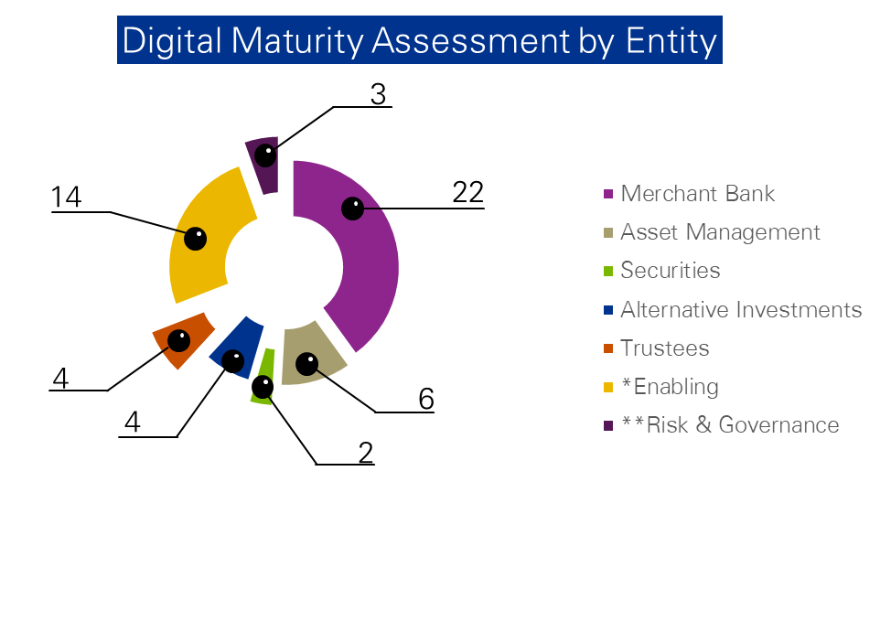
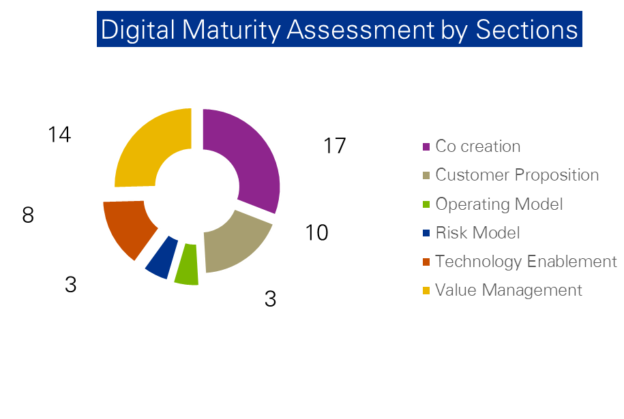
Background
2A
Digital Maturity Assessment (DMA) Survey Coverage
The DMA survey cut across over fifty (50) stakeholders across the FBNQuest’s business entities and enabling functions, as follows:
The above chart shows the participation spread across various business entities for the Digital Maturity Assessment across all work streams in scope of the digital strategy.
The above chart shows the spread of participation firm wide across the various work streams for the Digital Maturity Assessment
*Enabling – Information Technology, Human Resources, Corporate Communication & Marketing, Operations and General Services
**Risk & Governance – Strategy, Risk, Compliance, FINCON, Legal and Audit
Refer to Appendix – DMA Survey Coverage for details

Slide 8


















Background
2B
Peer Group & Global Industry Benchmark
FBNQuest was benchmarked against a wide variety of local peers and global leaders in its lines of business as identified below:

Slide 9
Key Findings & Initiatives
Notes:
Change colours
Ecosystem scanning
CRM

Slide 10


Key Findings & Initiatives
Digital Maturity Assessment Result Summary
Overall Assessment of FBNQuest’s Digital Maturity Level
Key:
Current
Peer Group
Global Industry Benchmark
Aspiration
*Domain
Weighting
Lagging
Basic
Progressed
Leading
Innovating
VALUE
MANAGEMENT
CUSTOMER
EXPERIENCE MGT.
10%*
5
4
3
2
1
0
30%*
Whilst FBNQuest is currently digitally immature, a number of digital initiatives have been identified to support the Group’s ambition to grow the business significantly within the next 3 years.
Historically, FBNQuest has offered personalized customer engagement through Relationship Managers rather than via electronic channels.
The online and mobile platform were found to offer limited transactional or servicing capabilities.
Enabling segments of the business also rely on traditional methods, and will require significant changes to culture and processes to accommodate the digital transformation objectives.
Overall FBNQuest’s digital maturity level was found to be lagging behind both local and global peers in the industry.
RISK
MODEL
OPERATING
MODEL
10%*
10%*
20%*
20%*
CO-CREATION
MODEL
TECHNOLOGY
ENABLEMENT
1
Lagging
2
Basic
3
Progressed
4
Leading
5
Innovating
Refer to Appendix – Detailed weighting & scoring approach for details

Slide 11



Key Findings & Initiatives
Key:
Current
Global Industry Benchmark
Aspiration
Value Management
Peer Group
The following key initiatives have been identified for FBNQuest with respect to Value Management:
Defining the ambition that set the agenda for digital with clearly articulated key performance indicators.
Leadership Support & Executive Alignment | Ensure executive level ownership and accountability for digital strategy setting to better drive enterprise-wide acceptance and secure bold alignment at the top
Digital Initiatives Orchestration | Establish a system that identifies the digital initiatives with the most potential to have enterprise-wide impact
Goal Congruence | Approach digital ambition setting emphasizing coordination at all levels of the corporation – alignment at the top, agility in the middle and mobilization at the front line
Value Measurement | Develop a measurable framework of key performance indicators to monitor and report benefits from digital investments
Lagging
Basic
Progressed
Leading
Innovating
Clarity and consistency of vision & strategy
DBS is the first bank to develop a methodology to measure digital value creation – this is done by delineating customers into two segments – digital and traditional, then, defining measurable KPI for the across digital customers across Customer Growth, Transaction Volumes, Value Creation, Customer Experience, Ecosystem Partnerships & Footprint. Refer to Detailed Assessment – Value Management for details.
Utilisation of digital KPIs for value realisation & monitoring
Notes:
Largely within sales team
Engage with fintechs on some collaboration largely on an adhoc basis

Slide 12

Customer Experience Mgt.
Key Findings & Initiatives
Key:
Current
Global Industry Benchmark
Aspiration
Peer Group
The following key initiatives have been identified for FBNQuest with respect to Customer Experience Mgt.:
The capability to provide an optimal customer experience using digital to promote to, communicate with and service customers.
Digital Channels Adoption | Ensure use of social media channels to drive customer engagement and periodically track adoption of social media as a channel of interaction for customers
Tailored Customer Experience | Leverage data analytics for real-time analysis of customer behaviour and transaction trends and creation of better tailored customer experience and products
Personalised Digital Marketing | Ensure comprehensive use of customer analytics to target and personalise digital marketing activities
Digital Channels Enhancement | Enhance existing digital channels (web and mobile) to delivery competitive self-service functionalities for seamless customer experience across customer touch-points
Lagging
Basic
Progressed
Leading
Innovating
Utilisation of customer insight to drive customer satisfaction
Customer experience feedback and measurement
Increased adoption of ‘mobile first’ and ‘AI first’ i.e. delivery of tailored functionalities/ services to customers via mobile, leveraging AI (artificial intelligence) for predictive behavioural analysis.
Investments in digital content marketing to drive brand awareness.
Refer to Detailed Assessment – Customer Experience Management for details.
Data-driven digital marketing
Use of digital channels
Notes:
Largely within sales team
Engage with fintechs on some collaboration largely on an adhoc basis

Slide 13
Operating Model
Key Findings & Initiatives
Key:
Current
Global Industry Benchmark
Aspiration
Peer Group
The following key initiatives have been identified for FBNQuest with respect to Operating Model:
The extent to which an organisation is structured to deliver value to customers leveraging digital.
Digital Governance Structure | Establish a Centre of Excellence, led by the Chief Digital Officer, to overcome functional silos and ensure organisation-wide accountability for the digital agenda
Digital Workforce | Establish a talent development and acquisition strategy that will equip existing talent with digital skill-sets and acquire new talents (data scientists, software engineers etc.)
Process Digitisation | Leverage Artificial Intelligence and Robotics Process Automation to continually optimise performance
Lagging
Basic
Progressed
Leading
Innovating
Establishment of Robust Digital Governance Model
Digital workforce
Digital is recognised as a ‘standalone’ strategic business unit where a Chief Digital/Innovation Officer drives the digital agenda and reports to the CEO.
Automation, advanced robotics and artificial intelligence are used to improve employee productivity.
Refer to Detailed Assessment – Operating Model for details.
Digitisation of key operational processes
Notes:
Largely within sales team
Engage with fintechs on some collaboration largely on an adhoc basis

Slide 14

Key Findings & Initiatives
Key:
Current
Global Industry Benchmark
Aspiration
Technology Enablement
Peer Group
The following key initiatives have been identified for FBNQuest with respect to Technology Enablement:
The extent to which an organisation monitors its own technology footprint in the digital marketplace and reacts to improve and enhance its digital propositions through the implementation and application of technology enablers.
API Management | Implement an API solution manager to better operate FBNQuest’s integration architecture
API Monetisation | Expose FBNQuest’s strategic products externally via APIs to diversify revenue streams, enable customer growth and support partnerships
Cloud Governance | Establish and execute a cloud governance framework to continuously guide the measurement, monitoring, tracking and prediction of cloud take-up
Data and Analytics Automation | Develop a business intelligence (BI) and analytics strategy and road map to facilitate the execution of intelligent reporting and analysis
User Experience Improvement | Establish and document a framework to guide proactive measurement of user experience and continuous improvement of the process
Lagging
Basic
Progressed
Leading
Innovating
API implementation and management
Scalable cloud hosting models
Global players are adopting robust API and cloud strategies
90% of Goldman Sachs servers (over 200,000) are cloud hosted
DBS and JP Morgan have exposed over 150 live APIs
Hackathons are key to driving API adoption by external developers and Fintechs
Refer to Detailed Assessment – Technology Enablement for details.
Optimal utilisation of data & analytics and artificial intelligence
Application of best practice user experience standards
Notes:
Largely within sales team
Engage with fintechs on some collaboration largely on an adhoc basis

Slide 15
Key Findings & Initiatives
Key:
Current
Global Industry Benchmark
Aspiration
Co-creation Model
Peer Group
The following key initiatives have been identified for FBNQuest with respect to Co-creation Model:
The extent to which an organisation monitors its own technology footprint in the digital marketplace and reacts to improve and enhance its digital propositions through the implementation and application of technology enablers.
Innovation Strategy | Develop an innovation strategy that is aligned with the business strategy, and clearly communicated to all FBNQuest staff. This should define the strategy for internal and external innovation sourcing
Innovation Sourcing Platform | Develop a platform to streamline and reward generation of innovative initiatives by FBNQuest staff
Partnership Assessment Metrics | Establish and measure performance metrics to ensure that alliances and partnerships regularly add value to FBNQuest
Lagging
Basic
Progressed
Leading
Innovating
Establishment of Innovation Strategy
Mature internal innovation sourcing processes and platforms
Goldman Sachs has launched an in-house incubator, dubbed GS Accelerate, aimed at encouraging employees to develop new innovative solutions.
Citi is expanding the network of its Global Innovation Labs with the opening of a new hub in London.
Refer to Detailed Assessment – Co-creation Model for details.
Measured and value-driven digital partnerships & collaborations
Notes:
Largely within sales team
Engage with fintechs on some collaboration largely on an adhoc basis

Slide 16
Key Findings & Initiatives
Key:
Current
Global Industry Benchmark
Aspiration
Risk Model
Peer Group
The following key initiatives have been identified for FBNQuest with respect to Risk Model:
The extent to which an organisation monitors the inherent risks in its operating environment and the risks that it will be exposed to upon the commencement of the digital journey
Digital Risk Strategy and Framework | Develop a robust digital risk strategy and framework for adequate management and mitigation of digital risks
Cybersecurity Governance | Adequate staffing of cybersecurity function to ensure security activities are carried out by personnel within the dedicated function
Cybersecurity Strategy and Framework | Develop a cybersecurity strategy with initiatives that align with business and IT strategy. Develop a framework to guide implementation of cybersecurity initiatives
Vulnerability Management | Perform periodic credentialed scan of IT assets (operating system, web applications, network devices and databases) to ensure completeness of scan scope
Security Monitoring | Implement adequate monitoring of IT infrastructure for prompt identification and resolution of security events
Lagging
Basic
Progressed
Leading
Innovating
Risk Governance
Risk Monitoring
Risk is managed through a framework designed to balance strong corporate oversight with well-defined independent risk management. This framework includes the definition of cybersecurity risks.
Citi have pledged to partner with key financial service players and government agencies to establish a unified response to cybersecurity threats.
Refer to Detailed Assessment – Risk Model for details.
Risk Definition & Ownership
Cybersecurity
WIP
Notes:
Largely within sales team
Engage with fintechs on some collaboration largely on an adhoc basis

Slide 17
Detailed Assessment
Notes:
Change colours
Ecosystem scanning
CRM

Slide 18
Key:
Current
Peer Group
Global Industry Benchmark
Aspiration
Value Management
Value Management Defining the ambition that set the agenda for digital with clearly articulated key performance indicators.
Maturity Indicators
Clarity and consistency of vision & strategy
56%
Utilisation of digital KPIs for value realization & monitoring
44%
Lagging | Basic | Progressed | Leading | Innovating
No documented digital strategy
Lack of clarity on the roles and responsibilities of individuals in setting the digital ambition
No approach to measuring performance of digital initiatives
Employees’ KPIs are not linked to digital KPIs
Vaguely documented digital strategy
Digital ambition setting is done in silos and is not linked to the wider corporate strategy
Basic but coherent framework to measuring and reporting KPIs
Digital KPIs are linked to departmental KPIs
Set of documented digital strategy that is yet to be fully communicated across the organisation
Digital strategy is structured in a way that can only deliver tactical change within the organisation
Clear relationships between digital KPIs and high level business drivers
Set of documented digital strategy that is communicated only to executive management
Digital strategy is structured in a way that can deliver both tactical and strategic change within the organisation
Employees’ KPIs are linked to digital KPIs but are not regularly monitored
Set of documented digital strategy that is well communicated across the organisation
Digital strategy is structured in a way that can deliver both tactical and strategic change within the organisation
Employees’ KPIs are linked to digital KPIs and regularly monitored
Maturity Levels
Level 1
Level 2
Level 3
Level 4
Level 5
Notes:
Change colours
Ecosystem scanning
CRM

Slide 19
Key:
Current
Global Industry Benchmark
Detailed Assessment – Value Management^{(1/5)}
Aspiration
Co creation
Peer Group
Maturity Indicators |  | Current State | Peer Group | Global Industry Benchmark
Clarity and consistency of vision & strategy |  | No documented enterprise digital ambitions & strategy. Pockets of digital initiatives are siloed within the business entities. There are a number of planned and ongoing activities which the Bank believes will guide achievement of its goals, however, these initiatives are vaguely documented and not fully known to both leadership and employees. FBNQuest has a good understanding of its strategic objectives, however, there is no clear alignment with a digital strategy. | A common observation among FBNQuest peers is the existence of a high-level digital strategy and initiatives, though in some cases, vaguely documented. These initiatives are updated on a periodic basis and widely known to both executive management and employees. | In early 2017, Goldman Sachs design and implemented an enterprise-wide digital strategy – one of the key outcomes of a leadership that sees the company as not just a technology firm, but a platform. With the support of its Management Committee and senior leadership, Goldman created a technology strategy for modernising the firm with a focus on internal efficiencies and creation of both internal and external platforms. DBS Bank has a set of documented digital strategy which highlights all the key elements of its digital journey. This was formalised and communicated to both leadership and employees. Refer to Appendix – Value Management for details. Lloyds plans to make banking simple and easier for customers whilst reducing operating costs over the next three years. It has three core drivers of its digital strategy. Refer to Appendix – Value Management for details.
Source: DMA survey, interviews with FBNQuest employees, company websites, exploratory interviews

Slide 20
Key:
Current
Global Industry Benchmark
Detailed Assessment – Value Management^{(2/5)}
Aspiration
Co creation
Peer Group
Maturity Indicators |  | Lagging | Basic | Progressed | Leading | Innovating
Clarity and consistency of vision & strategy (cont’d) |  | There is no set of documented digital ambitions or initiatives. Future business strategies do not take into consideration the importance of digital in attaining business growth. Roles and responsibilities are not clear in terms of where digital sits and who is accountable. There is a general tendency to a culture of aversion to digital initiatives with no plan to change in the near term. | Digital ambition setting is not dispersed across the organisation, but rather done in silos within an individual function. There is a set of documented digital aspirations that is vague and rarely considered. Digital aspirations are not linked to the firm's wider corporate strategy. There is skepticism towards adopting digital technologies with differing views on optimising digital technologies. | There is a set of documented digital aspirations that is not fully known to both leadership and employees. Digital ambitions are not updated and may sometimes be outdated. Digital ambition setting is recognised and structured in a manner that can only deliver change of a tactical nature. Functions operate in silos but collaborate as virtual teams for specific projects. Employees have access to digital technologies and there is a high level strategy for increasing digital adoption. | There is a set of documented digital aspirations that is well understood by leadership but not fully known to employees below the executive level. Digital ambition setting is recognised and structured in a manner that can deliver change of a tactical and strategic nature. The organisation is digitally competent but has a culture of caution in adopting new technologies. | There is a set of documented digital aspirations that is updated regularly and fully aligned with the wider corporate strategy. Digital ambition setting is well dispersed across the organisation and the organisation shares a collaborative vision for digital success. Leadership and employees are empowered to fully embrace digital initiatives and are advocates of innovation. The organisation is digitally competent and use of digital is central to how the business operates.
Source: DMA survey, interviews with FBNQuest employees, company websites, exploratory interviews

Slide 21
Key:
Current
Global Industry Benchmark
Detailed Assessment – Value Management^{(3/5)}
Aspiration
Co creation
Peer Group
Source: DMA survey, interviews with FBNQuest employees, company websites, exploratory interviews
Maturity Indicators |  | Current State |  | Peer Group |  | Global Industry Benchmark
Utilisation of digital KPIs for value realization & monitoring |  | FBNQuest digital ambition is not regularly measured or reported. As a result necessary actions are not taken to monitor digital KPIs (largely because these KPIs are not pre-defined and agreed). Sound investment cases may be factored in the budgeting and spending decisions for siloed digital initiatives, however these investments in digital are rarely measured against the anticipated benefits. |  | Best practice among the peers is to have a set of documented KPIs, however these KPIs are not linked to employees KPIs. |  | DBS is the first bank to develop a methodology to measure digital value creation – this is done by delineating customers into two segments – digital and traditional, then, defining measurable KPI for the across digital customers across Customer Growth, Transaction Volumes, Value Creation, Customer Experience, Ecosystem Partnerships & Footprint. Refer to Appendix – Value Management for details.
 |  | Lagging | Basic | Progressed | Leading |  | Innovating
 |  | There is an arbitrary approach to measuring and reporting on digital KPIs. KPI does not link employees/divisional digital performance to the Firm's digital success. | There is a basic but coherent framework approach to measuring and reporting on digital KPIs. Broad KPIs exist but typically measures divisional performance against the Firm's digital success. | There is a well established KPI tree with clear relationships between digital KPIs and high level business drivers. The uptake of digital across the organisation is consistently measured via departmental KPIs. | There is a comprehensive KPI tree with clear relationships between digital KPIs and high level business drivers. Employee performance is linked to the Firm's digital success but these KPIs are neither monitored nor reviewed regularly. |  | There is a comprehensive KPI tree with clear relationships between digital KPIs and high level business drivers. Employee performance is linked to the organisation's digital success, closely monitored and reviewed regularly.

Slide 22
Detailed Assessment – Value Management^{(4/5)}
Proposed Aspirations for FBNQuest
An organisation that has a well documented set of digital ambitions that is cascaded to all employees across its business entities
An organisation that has a clearly articulated key performance measures for digital initiatives
An organisation whose digital KPIs are linked to employee and departmental KPIs

Slide 23


Detailed Assessment – Value Management^{(5/5)}
Proposed Initiatives
Leadership Support & Executive Alignment
Digital Initiatives Orchestration
Goal
Congruence
Value
Measurement
Ensure executive level ownership and accountability for digital strategy setting to better drive enterprise-wide acceptance and secure bold alignment at the top
Establish a system that identifies the digital initiatives with the most potential to have enterprise-wide impact
Approach digital ambition setting emphasizing coordination at all levels of the corporation—alignment at the top, agility in the middle and mobilization at the front line
Develop a measurable framework of key performance indicators to monitor and report benefits from digital investments

Slide 24
Key:
Current
Peer Group
Global Industry Benchmark
Aspiration
Customer Experience Management The capability to provide an optimal customer experience using digital to promote to, communicate with and service customers.
Maturity Indicators
Utilisation of customer insight to drive customer satisfaction
28%
Customer experience feedback and measurement
24%
Data-driven digital marketing
24%
Use of digital channels
24%
Lagging | Basic | Progressed | Leading | Innovating
Little or no use of customer analytics with unconsolidated data across the organization.
No meaningful metric in place for measuring customer experience.
No defined strategy, team or process for digital marketing.
Little to no integration across channels.
Little focus on customer analytics.
General customer experience metrics with emphasis on reducing costs.
Views digital as a new marketing channel and allocates budget and staff accordingly.
Integration across channels exists but is not consistently useful.
Some focus on customer analytics with centralized management of customer data.
Customer experience metrics are in place with specific customer experience KPIs.
Defined, integrated digital marketing strategy.
Integrated, cross-channel visibility.
Utilization of sophisticated data analytics tools.
Significant customer experience metrics to improve customer experience.
Personalised and predictive marketing based on customer behaviour.
Holistic, cross-channel customer engagement.
Market leading focus on customer analytics with specialized data and analytics teams.
Significant customer experience metrics that supports organisation strategy.
Digital marketing is a key component of customer engagement strategy.
Permanent and repeatable Omni-channel journeys.
Maturity Levels
Level 1
Level 2
Level 3
Level 4
Level 5
Notes:
Change colours
Ecosystem scanning
CRM

Slide 25

Key:
Current
Global Industry Benchmark
Detailed Assessment – Customer Experience Mgt.^{(1/6)}
Aspiration
Co creation
Peer Group
Maturity Indicators |  | Current State |  |  | Peer Group |  | Global Industry Benchmark
Utilisation of customer insight to drive customer satisfaction |  | Customer data is stored in various databases, with demographic and transactional data collected disparately, resulting in no single comprehensive view of the customer. No evidence of data analytics used to draw insights from customer behavior, offer personalised offerings and optimise overall customer experience. Presence of missing customer data fields in some cases e.g. bio data, thus limiting the organisation’s understanding of its customers. |  |  | Customer data is analysed by a dedicated data and analytics team and customised offerings are provided based on this analysis. |  | Data-driven insights from several sources is integrated onto one platform, equipping Relationship Managers with a 360-degree view of the customer. Behavioral and transactional data is used to personalise and predict future needs for customers and tailor advisory services based on client’s investing goals.
 |  | Lagging | Basic | Progressed |  | Leading |  | Innovating
 |  | Little or no use of customer analytics. There is a large amount of customer data collected and this is not consolidated centrally. | Little focus on customer analytics with no structured approach to processing or consolidating customer data. | Some focus on customer analytics and how it can be leveraged to improve customer experience. Customer data is managed centrally and the organisation has invested in a Big Data platform, with models in place (or being designed) to predict customer behaviour. |  | Real focus on customer analytics and uses sophisticated data analytics tools to manage both structured and unstructured customer data. Customer data is collected from and provided to all areas of the organization. |  | Market-leading focus on customer analytics, with specialised data and analytics teams in place for regular customer touch points. It is widely recognised that effective use of customer data is a key element of the organisation’s competitive advantage.
Source: DMA survey, interviews with FBNQuest employees, company websites, exploratory interviews
Refer to Appendix – Customer Experience Mgt. for details.

Slide 26
Key:
Current
Global Industry Benchmark
Detailed Assessment – Customer Experience Mgt.^{(2/6)}
Aspiration
Co creation
Peer Group
Source: DMA survey, interviews with FBNQuest employees, company websites, exploratory interviews
Maturity Indicators |  | Current State |  | Peer Group |  | Global Industry Benchmark
Customer experience feedback and measurement |  | Perception surveys are deployed to customers occasionally. No clear structure for integrating customer feedback into actionable insights and decision making across the firm, partly due to nature of survey measures. Feedback via digital channels is not currently enabled. |  | Feedback is solicited from customers about their experiences through surveys and interviews. Customers can submit complaints and / or queries via digital channels. Customers have the ability to instigate "live chat" through digital channels to ask questions or get support. |  | Proactive collection and monitoring of feedback from customers on their experiences through calls, emails, or mining social media posts. Customers have the ability to converse with agents in real time through digital channels to resolve any issues or provide feedback. Relentless focus on action planning, both at the operational and strategic level using voice of the customer feedback.
 |  | Lagging | Basic | Progressed | Leading |  | Innovating
 |  | Inconsistently reactive to customers' feedback digitally. Customers are not kept informed on the progress of queries and / or complaints via digital channels. No meaningful metric for measuring customer experience. | Static tools are in place to deal with customer queries online. Feedback is sporadically captured through digital channels. Some general customer experience metrics are in place, e.g. Customer Satisfaction Index (CSI). | More proactive in dealing with online customer queries, complaints and feedback. Specific customer experience KPIs are collected, evaluated and used to drive the customer experience agenda. | Proactive in dealing with online customer queries, complaints and feedback. There are significant customer experience metrics in place and specific objectives are set to improve customer experience. |  | Manage online customer queries feedback and complaints proactively and in real time. Significant customer experience metrics in place that support objectives to provide the highest level of customer experience
Refer to Appendix – Customer Experience Mgt. for details.

Slide 27
Key:
Current
Global Industry Benchmark
Detailed Assessment – Customer Experience Mgt.^{(3/6)}
Aspiration
Co creation
Peer Group
Source: DMA survey, interviews with FBNQuest employees, company websites, exploratory interviews
Maturity Indicators |  | Current State |  |  | Peer Group |  | Global Industry Benchmark
Data-driven digital marketing |  | There is no defined digital marketing strategy. Dedicated resource for handling digital marketing is present. An external marketing agency shares data derived from social media channels. However there is no evidence that this data is utilised in personalising marketing information. |  |  | High brand visibility across social media channels to improve brand awareness. Dedicated digital marketing team. |  | Use of contextual marketing driven by big data analytics resulting in double-digit increase in revenues from campaigns. Enormous investments in digital content marketing to drive brand awareness. Bulk of marketing activities is digital with a heavy focus on content creation and social media, relying on ample data available.
 |  | Lagging | Basic | Progressed |  | Leading |  | Innovating
 |  | No defined strategy or set budget for digital marketing. Digital marketing is used in an experimental way, without set targets or objectives. | Digital marketing is used experimentally but the organisation does track performance and measure success. There is a dedicated digital marketing team that focuses on SMS, email and banner advertising. Messaging is targeted at a segment level but is not personalised to individuals. | Digital marketing is viewed as a core component of their annual marketing spend. Messaging is consistent through both offline and digital channels. Customer data and analytics is utilised to target and personalise digital marketing activity. |  | Most leads are generated through digital marketing. Digital marketing is seen as the key marketing channel, and budget is allocated as such. All marketing is delivered device agnostic and messaging is unified across channels. |  | Majority of the budget is dedicated to digital marketing. The digital marketing and engagement strategy is embedded within the overall business strategy. All messaging is personalised to the individual with ability to push contextual information across integrated media.
Refer to Appendix – Customer Experience Mgt. for details.

Slide 28

Key:
Current
Global Industry Benchmark
Detailed Assessment – Customer Experience Mgt.^{(4/6)}
Aspiration
Co creation
Peer Group
Source: DMA survey, interviews with FBNQuest employees, company websites, exploratory interviews
Maturity Indicators |  | Current State |  | Peer Group |  |  | Global Industry Benchmark
Use of digital channels |  | Existence of digital channels with limited functionalities in comparison with local and global benchmarks. Refer to Annexure – Digital Channels Review for details. Customers can access the website for information on product and service offerings. |  | Multichannel experience exists across digital channels. Social media is used as a channel of interaction for customers .e.g. complaints management, product marketing, general information dissemination etc. |  |  | Seamless omnichannel experience across all channels including digital banking, call centers and branches, to improve customer experience. Adoption of ‘mobile first’ and ‘AI first’ i.e. delivery of tailored functionalities/ services to customers via mobile, leveraging AI (artificial intelligence) for predictive behavioural analysis.
 |  | Lagging | Basic |  | Progressed | Leading |  | Innovating
 |  | There is little to no integration across channels, limiting the ability of customers to have smooth journeys across multiple channels. . Engagements on social media such as "listening" are ad-hoc and generally initiated on the back of a customer issue | There is a channel strategy in place which provides limited guidance for managing customer experiences across various channels. Integration across channels exists but is not consistently useful. Content is created on social media, but quality and control varies. |  | Integrated, cross-channel visibility. There is a single view of customer data, interactions, and transactions across multiple channels, in near-real time. Customer sentiment is monitored on social media and awareness is generated through social media advertising. | Holistic, cross-channel customer engagement. Customer engagement in each channel is informed by offers and interactions in other channels. |  | Customer experience is optimised across integrated channels. Delivery of permanent and repeatable omnichannel journeys and processes.
Refer to Appendix – Customer Experience Mgt. for details.

Slide 29
Detailed Assessment – Customer Experience Mgt.^{(5/6)}
Proposed Aspirations for FBNQuest
Firm-wide focus on customer behaviour and insights to drive strategic initiatives
Utilisation of data analytics to drive personalisation of customer propositions
Defined digital marketing strategy for end-to-end integration of all digital marketing platforms
Significant use of social media to drive and measure customer engagement
Seamless customer experience across integrated channels and customer touchpoints

Slide 30
Detailed Assessment – Customer Experience Mgt.^{(6/6)}
Proposed Initiatives
Digital Channels Adoption
Tailored Customer Experience
Personalised digital Marketing
Digital Channels Enhancement
Ensure use of social media channels to drive customer engagement and periodically track adoption of social media as a channel of interaction for customers
Leverage data analytics for real-time analysis of customer behaviour and transaction trends and creation of better tailored customer experience and products
Ensure comprehensive use of customer analytics to target and personalise digital marketing activities
Enhance existing digital channels (web and mobile) to delivery competitive self-service functionalities for seamless customer experience across customer touch-points

Slide 31
Key:
Current
Peer Group
Global Industry Benchmark
Aspiration
Operating Model The extent to which an organisation is structured to deliver value to customers leveraging digital.
Maturity Indicators
Establishment of robust digital governance model
38%
Digital workforce
24%
Digitisation of key operational processes
38%
Lagging | Basic | Progressed | Leading | Innovating
Absence of digital governance framework.
Absence of digital skills/ roles.
Largely dependent on manual processes.
Minimal adoption of digital policies.
Absence of digital skill acquisition strategy.
Partially digitised core processes.
Clear leadership and ownership of digital.
Presence of key digital capabilities.
Largely digitised core processes.
Digital is strategic to the functioning of the organization.
Expert innovation teams.
Digitation of core and support processes.
Digital is the prime strategy of the organisation.
Largely digital workforce.
Fully automated processes.
Maturity Levels
Level 1
Level 2
Level 3
Level 4
Level 5
Notes:
Change colours
Ecosystem scanning
CRM

Slide 32
Key:
Current
Global Industry Benchmark
Detailed Assessment – Operating Model^{(1/5)}
Aspiration
Co creation
Peer Group
Maturity Indicators |  | Current State |  | Peer Group |  | Global Industry Benchmark
Establishment of Robust Digital Governance Model |  | Establishment of an Innovation Committee chaired by the Chief Operating Officer. Presence of a Chief Technology and Digital Officer reporting to the COO. |  | Presence of a Chief Digital Officer that reports to the CEO. |  | Digital is recognised as a ‘standalone’ strategic business unit where a Chief Digital/Innovation Officer drives the digital agenda and reports to the CEO.
 |  | Lagging | Basic | Progressed | Leading |  | Innovating
 |  | No significant focus on digital within standard governance framework. Little or no investment in developing or enhancing digital capabilities. | The CIO/CTO has a good understanding of emerging digital technologies. Low level of digital capability within the organisation, which is randomly dispersed. | Function-level governance takes account of digital issues. Recognised and structured digital capability within the organisation but can only deliver change of a tactical nature. | Governance framework supports rapid decision making and resource allocation at a cross-functional level. Recognised and structured digital capability that can deliver significant digital change within the organisation. |  | The Board adopts a ‘digital first’ approach to all appropriate business issues. Digital governance sits centrally within the business, and acts as a digital centre of excellence delivering significant change in an agile manner.
Source: DMA survey, interviews with FBNQuest employees, company websites, exploratory interviews
Refer to Appendix – Operating Model for details.

Slide 33
Key:
Current
Global Industry Benchmark
Detailed Assessment – Operating Model^{(2/5)}
Aspiration
Co creation
Peer Group
Maturity Indicators |  | Current State |  | Peer Group |  |  | Global Industry Benchmark
Digital workforce |  | Establishment of an Innovation Committee chaired by the Chief Operating Officer. Presence of a Chief Technology and Digital Officer reporting to the COO. |  | Presence of data scientists that deliver data-driven insights to business units. Presence of software engineers responsible for design and deployment of APIs.. |  |  | Employment of data scientists, progammers, data analysts, software engineers, etc. Creation of a curriculum to train staff on digital skills. Hackathons are conducted to create digital learning experiences for staff. Automation, advanced robotics and artificial intelligence are used to improve employee productivity.
 |  | Lagging | Basic |  | Progressed | Leading |  | Innovating
 |  | No clear strategy for engaging employees about digital capabilities. Minimal awareness of the potential for digital to optimise operations. There are no prescribed digital roles and responsibilities within functions. | No formal strategy for informing employees about the importance and potential of digital. No central focus placed on educating employees about digital capabilities. Defined digital roles and responsibilities within individual functions. |  | Formal strategy for engaging employees with digital across the organisation. Established groups of digital experts in individual functions, responsible for implementing the digital strategy. | Employees consistently use digital tools in their day-to-day working. Dedicated digital SMEs across the business to provide digital support and guidance to all teams and functions within the organisation. |  | Organised digital expertise in a Centre of Excellence. All staff are aware of the organisation’s digital capability and regularly use innovative solutions to improve organisational performance.
Source: DMA survey, interviews with FBNQuest employees, company websites, exploratory interviews
Refer to Appendix – Operating Model for details.

Slide 34
Key:
Current
Global Industry Benchmark
Detailed Assessment – Operating Model^{(3/5)}
Aspiration
Co creation
Peer Group
Maturity Indicators |  | Current State |  | Peer Group |  | Global Industry Benchmark
Digitisation of key operational processes |  | Most processes exist and are well defined. However, they are not all properly documented. All processes are largely manual, with only a few automated such as file storage, risk register etc. |  | Operate automated share registration services. Automated investment purchase and redemption processes. |  | Automated trading platform with digitised settlement processes and some IPO processes.
 |  | Lagging | Basic | Progressed | Leading |  | Innovating
 |  | Largely dependent on manual processing and paper-based records. Processes may make use of digital in some or even most steps but these steps are not integrated in a single workflow and re-keying abounds. | Core processes may be all or substantially straight through processed. Physical locations have some ability to initiate processes digitally reducing the need for paper. | All core customer processes are straight through processed. Most processes in physical locations have a digital front-end and the requirement for paper forms is minimal as most internal processes are digital. | All major customer processes are straight through processed and auxiliary are supported by effective digital platforms. Processes in physical locations are fully supported by digital tools. |  | Paper based processes are not found except where quality demands. Internal and external processes are designed and built on a digital basis and digital processes are supported by smart algorithms.
Source: DMA survey, interviews with FBNQuest employees, company websites, exploratory interviews

Slide 35
Detailed Assessment – Operating Model^{(4/5)}
Proposed Aspirations for FBNQuest
Effective Digital Governance framework with clear leadership and ownership of digital in the organisation
Ownership of a robust digital workforce capable of developing innovative customer centric solutions and building products to drive growth
Automation of core customer processes and support of auxiliary processes by effective digital platforms

Slide 36
Detailed Assessment – Operating Model^{(5/5)}
Proposed Initiatives
Digital Governance Structure
Digital Workforce
Process Digitisation
Establish a Centre of Excellence, led by the Chief Digital Officer, to overcome functional silos and ensure organisation-wide accountability for the digital agenda
Establish a talent development and acquisition strategy that will equip existing talent with digital skill-sets and acquire relevant talent (data scientists, software engineers etc.)
Leverage Artificial Intelligence and Robotics Process Automation to continually optimise performance

Slide 37
Key:
Current
Peer Group
Global Industry Benchmark
Aspiration
Technology Enablement The extent to which an organisation monitors its own technology footprint in the digital marketplace and reacts to improve and enhance its digital propositions through the implementation and application of technology enablers.
Maturity Indicators
API implementation and management
28%
Cloud adoption
24%
Optimal utilization of data & analytics and artificial intelligence
24%
Application of best practice user experience (UX) standards
24%
Lagging | Basic | Progressed | Leading | Innovating
No API strategy, implementation, publishing, documentation or monitoring of API metrics
Limited awareness and zero adoption of cloud hosting & computing capabilities.
No data & analytic strategy, resources or processes
No User Experience (UX) strategy to manage user experience though its importance is recognised
No API strategy. Few APIs are implemented and published locally with no comprehensive documentation or monitoring of API metrics. No open API capability and adoption.
Cloud capabilities are limited as its adoption is only applied opportunistically with no comprehensive plan.
Execution of data & analytics efforts in an ad-hoc manner in the absence of a strategy
Emergence of UX processes with some management support but no documented strategy.
Poor API strategy but some APIs are implemented and published locally with limited documentation but no developer portal or monitoring of API metrics. Adoption of partner APIs.
Wide acceptance of a cloud strategy which is aligned with business outcomes.
Existence of data & analytics tools and processes which are different for different functions.
Documented UX strategy to manage and guide user experience processes.
Partially executed API strategy. Capabilities for API documentation, central publishing and monitoring, with few open APIs.
Measurement and quantitative management of cloud capabilities in line with the cloud strategy.
Existence of data & analytical strategy, tools and processes to support multiple functions.
Establishment of metrics to measure & control UX which has been identified as one of the core tenets of the organisational strategy.
Strategy-driven API implementation.
Adequate API documentation, central publishing, monitoring and fully open and monetized APIs.
Proactive monitoring of assets to inform strategic decisions on further cloud adoption.
Existence of dedicated, well funded and highly skilled data & analytical tools and processes to support multiple functions in line with a strategy.
Continuous measurement & improvement of user experience management process.
Maturity Levels
Level 1
Level 2
Level 3
Level 4
Level 5
Notes:
Change colours
Ecosystem scanning
CRM

Slide 38
Key:
Current
Global Industry Benchmark
Detailed Assessment – Technology Enablement^{(1/10)}
Aspiration
Co creation
Peer Group
Maturity Indicators |  | Current State | Peer Group | Global Industry Benchmark
API implementation and management |  | APIs are recognised and appreciated as a key enabler to achieve digital initiatives; An API strategy is yet to be developed and documented; An API governance framework including roles and responsibilities is yet to be defined; A few APIs have been implemented for internal consumption; There are predominant point-to-point type integrations in the architectural landscape; The available API documentation are inadequate in terms of specifications and design; APIs are published on local servers for access; Expertise to build, optimise and manage APIs (including number of resources and availability of tools) are insufficient. | Minimal API capabilities are exhibited. Specifically, no comprehensive API strategy exists and fully open APIs are not yet adopted, however, some externally hosted services are consumed application within the internal IT landscape. | DBS Bank developed and documented an API strategy including an open API strategy; The bank was noted to have launched the world’s largest banking API platform as at November 2017; DBS Bank and JP Morgan have exposed over 150 live APIs externally; DBS Bank staff are made to participate in API hackathons organised for the general public as well as other API skill development activities; Goldman Sachs has implemented open APIs for their banking assets (e.g. customer relationship management, access to data, analytics & execution from a browser); The investment bank has also proactively invested in the number and expertise of API software engineers in their organisation.
Source: DMA survey, interviews with FBNQuest employees, company websites, exploratory interviews
Refer to Appendix – Technology Enablement for details.

Slide 39
Key:
Current
Global Industry Benchmark
Detailed Assessment – Technology Enablement^{(2/10)}
Aspiration
Co creation
Peer Group
Maturity Indicators |  | Lagging | Basic | Progressed | Leading | Innovating
API implementation and management (cont’d) |  | No API strategy, implementation, publishing, documentation or monitoring of API metrics. Predominantly point-to-point type integrations between applications/ systems. | No API strategy but a few APIs are implemented and published on local servers. There is no documentation, developer portal or monitoring of API metrics. Some internal system integrations are via closed APIs, however point-to-point type integrations are largely predominant. Externally hosted APIs are consumed by internal systems, but business assets are not exposed via open APIs. | Documented API strategy that is largely not executed and not regularly updated. Some APIs are implemented and published on local servers with limited documentation but there is no developer portal or monitoring of API metrics. Externally hosted APIs are consumed by internal systems, and certain business assets are exposed via APIs but to a closed developer group (i.e. partner APIs). | Documented, partially executed and periodically updated API strategy to guide the implementation and use of APIs There are capabilities for adequate API documentation, a developer portal, central publishing of all APIs, API monetisation and monitoring of some API metrics. Adoption of a service oriented architecture (SOA) with integrations largely via APIs. Externally hosted APIs are consumed by internal apps. While a fully open API architecture is not adopted, certain business assets are exposed via open APIs. Innovation sourcing activities (e.g. hackathons) are used to promote internal and external adoption of bank APIs. | Documented, fully executed and regularly updated API strategy. Adoption of SOA powered by APIs. In addition to utilisation of closed APIs for system integrations internally and the integration of internal apps/ systems with externally hosted APIs, a fully open API architecture is adopted to extend business assets (e.g. platforms, data, processes, features, etc.) to the external ecosystem. Open APIs are strongly leveraged as a new business model that generates new revenues streams and drives partnerships and collaboration. API experience (APX) and documentation is at the heart of the development/ publishing of open APIs. Existence of centralised API development, repository, management and analytics/ monitoring capabilities. Innovation sourcing activities (e.g. hackathons) are used to promote internal and external adoption of bank APIs.
Source: DMA survey, interviews with FBNQuest employees, company websites, exploratory interviews

Slide 40
Key:
Current
Global Industry Benchmark
Detailed Assessment – Technology Enablement^{(3/10)}
Aspiration
Co creation
Peer Group
Maturity Indicators |  | Current State | Peer Group | Global Industry Benchmark
Cloud adoption |  | Cloud adoption is recognised as a key enabler to achieve rapid scalability and reduction of infrastructure costs, however it has not been widely accepted and applied by the organisation. Tools are in place to track the performance, usage and obsolescence of IT infrastructure. Though a large number of infrastructure is co-located, cloud hosting and computing capabilities are limited, including SaaS for Customer Relationship Management {CRM} (i.e. Salesforce), SaaS for incident and service management (i.e. TOPdesk), IaaS for hosting Athena AM & SEC, iDeal Funds and Oracle (Financials & HR). | Some organisations have their data centers co-located, however cloud hosting and computing capabilities are limited. Cloud services models identified include: SaaS for incident management (i.e. Remedy) and SaaS for Wireless Application Firewall. | Goldman Sachs has developed and documented a cloud strategy to guide the investment bank’s cloud adoption journey; The bank also owns over 200,000 servers to host its applications; 90% of which are housed on the cloud; Goldman Sachs has over time, moved to 100% virtual desktops; The investment bank deployed a fully cloud-based core banking solution (i.e. Finacle) to manage its complete consumer loan-servicing life cycle. JP Morgan strategically appointed an executive management personnel (specifically, Harish Grama from IBM) to be its CIO of cloud services; The bank also upgraded from its private cloud service model to a Platform as a Service (PaaS) model.
Source: DMA survey, interviews with FBNQuest employees, company websites, exploratory interviews
Refer to Appendix – Technology Enablement for details.

Slide 41
Key:
Current
Global Industry Benchmark
Detailed Assessment – Technology Enablement^{(4/10)}
Aspiration
Co creation
Peer Group
Maturity Indicators |  | Lagging | Basic | Progressed | Leading | Innovating
Scalable cloud hosting models (cont’d) |  | No documented cloud strategy or plan in place to implement or evaluate cloud based technology. Limited awareness and zero adoption of cloud hosting & computing capabilities. | Cloud adoption may be discussed or defined informally, however it has not been widely accepted by the organisation. Though there is an understanding of the benefits of cloud hosting & computing, a comprehensive cloud strategy is yet to be documented and agreed. Cloud hosting & computing capabilities are limited as cloud adoption is only applied opportunistically with no comprehensive or cohesive adoption plan. Tools and processes are established to track the performance, usage and obsolescence of IT infrastructure. | A cloud strategy, which is aligned with business outcomes, has been documented and agreed. There has been buy-in to the strategy across the organization and the approach is always (or nearly always) followed. | Processes and metrics have been defined to measure and quantitatively manage the organisation’s cloud capabilities while executing the cloud strategy (e.g. Proactive monitoring and collation of operational costs to depict cloud usage statisitics across the organisation, etc.) | Assets are proactively maintained to ensure relevancy and correctness. Metrics (backed by an adoption plan) inform strategic decision making about further cloud adoption in line with business outcomes.
Source: DMA survey, interviews with FBNQuest employees, company websites, exploratory interviews

Slide 42
Key:
Current
Global Industry Benchmark
Detailed Assessment – Technology Enablement^{(5/10)}
Aspiration
Co creation
Peer Group
Maturity Indicators |  | Current State | Peer Group | Global Industry Benchmark
Optimal utilisation of data & analytics and artificial intelligence |  | Absence of a data & analytics strategy to fully leverage the power of data in the organisation; Lack of a centralised, structured process to ensure that data collection is standardised; Absence of a dedicated data & analytics team; Lack of training programs geared towards data & analytics skills acquisition/ upgrade; Absence of a structure in place (i.e. data aggregator, collector or warehouse) that currently collects structured data to aid data analysis in the future; Lack of a deliberate process/practice in place to ensure new digital solutions support data analytics capabilities. | Review of the digital strategy of one of the asset management companies revealed its intention to invest in big data analytics; Generally, manual, ad-hoc data and analytics procedures are practiced and in some cases, a tool with analytic capabilities is utilised. | DBS Bank leveraged their existing customer data along with government data to create “DBS Home Connect”, a resource for home buyers; The investment bank also invested in its analytics staff strength by employing over 400 additional analytics resources; DBS Bank ensures that the application of data and analytics is pervasive throughout the organisation (e.g. in HR to reduce employee attrition, in marketing to provide advice communication to customers versus sales advice); Citigroup deployed a global, big data strategy to reduce manual reporting with a global 100 Full-time Equivalent (FTE) reduction; The group also launched an all-in-one platform called “Citi Velocity Clarity” to allow clients effectively monitor and analyse portfolio performance across a multiplicity of investments by leveraging the bank’s big data and analytics infrastructure.
Source: DMA survey, interviews with FBNQuest employees, company websites, exploratory interviews
Refer to Appendix – Technology Enablement for details.

Slide 43
Key:
Current
Global Industry Benchmark
Detailed Assessment – Technology Enablement^{(6/10)}
Aspiration
Co creation
Peer Group
Maturity Indicators |  | Lagging | Basic | Progressed | Leading | Innovating
Optimal utilisation of data & analytics and artificial intelligence (cont’d) |  | No data & analytics strategy, resources or processes. The organisation is collecting data internally and externally but no analysis is performed. | Execution of data & analytics efforts in an ad-hoc manner in the absence of a strategy. The organisation is collecting data internally and externally and sometimes performs analytics procedures. | Existence of some data & analytics tools, processes and capabilities which are different for different functions in the absence of a strategy to guide data analytics. | Existence of adequate data & analytics strategy, tools, resources and processes to support multiple functions in the organisation. | Existence of dedicated, well funded and highly skilled data & analytical tools and processes to support multiple functions in line with a strategy. Artificial intelligence capabilities are also present and applied.
Source: DMA survey, interviews with FBNQuest employees, company websites, exploratory interviews

Slide 44
Key:
Current
Global Industry Benchmark
Detailed Assessment – Technology Enablement^{(7/10)}
Aspiration
Co creation
Peer Group
Maturity Indicators |  | Current State | Peer Group | Global Industry Benchmark
Application of best practice user experience standards |  | A user experience strategy which is executed in line with the bank’s brand identity has been developed. However, the strategy is yet to be documented; The user interface designs for the bank’s digital channels are actively refreshed to keep abreast with changing customer expectations; Feedback on user experience is deliberately elicitated post-implementation. | Most of FBNQuest’s peer have developed and documented a user experience strategy which is strongly enforced in line with their respective organisations’ branding guidelines; Their user experience strategies are to an extent, widely known across their organisations and applied to guide the design and deployment of all customer facing applications and channels. | Charles Schwab bank appointed an executive management personnel to drive the governance of their organisation’s user experience strategy (specifically, Eliel Johnson, Vice President and Head of User Experience and Design); The bank also established a user experience research and design team focused on designing great software for their customers, investors and financial advisors; In addition, the bank constantly applies a prototype-first approach for digital solution implementation prior to actual build; Eastern Bank engaged a design and marketing firm with deep experience working with brand guidelines and implicit knowledge of the tenets of brand DNA to create a cohesive, consistent brand experience for their customers across all their touch points.
Source: DMA survey, interviews with FBNQuest employees, company websites, exploratory interviews
Refer to Appendix – Technology Enablement for details.

Slide 45
Key:
Current
Global Industry Benchmark
Detailed Assessment – Technology Enablement^{(8/10)}
Aspiration
Co creation
Peer Group
Maturity Indicators |  | Lagging | Basic | Progressed | Leading | Innovating
Application of best practice user experience standards (cont’d) |  | No user experience strategy to guide and manage user experience on all user touch-points (both internally and externally) though its importance to the organisation is recognised. | Emergence of some user experience processes with some level of executive management support but no documented strategy to guide the execution of the processes. | Documented user experience strategy to guide and manage user experience processes. Presence of a dedicated team to ensure the appropriate execution of the user experience strategy. | Establishment of metrics to measure & control user experience in addition to dedicated management of user experience processes. User experience has been identified as one of the core tenets of the organisation’s strategy. | Continuous measurement of user experience efforts and subsequent improvement of defined processes. Proactive elicitation of feedback from users to gauge the effectiveness of user experience management processes. User experience has been identified as part of the fabric of the organisation and not discussed separately.
Source: DMA survey, interviews with FBNQuest employees, company websites, exploratory interviews

Slide 46
Detailed Assessment – Operating Model^{(9/10)}
Proposed Aspirations for FBNQuest
An API-driven economy that deliberately monetises bank assets by exposing APIs to the external ecosystem
An organisation with adequate reliance on cloud service models to host the bank’s critical applications & infrastructure to aid scalability
An organisation that utilises sufficient data and analytics processes, tools and resources to perform business intelligence and intelligent reporting
An organisation that continuously measures and improves on user experience management which has been identified as part of the fabric of the organisation

Slide 47


Detailed Assessment – Operating Model^{(10/10)}
Proposed Initiatives
API Management
API Monetisation
Expose FBNQuest’s strategic products externally via APIs to diversify revenue streams, enable customer growth and support partnerships
Cloud Governance
Data and Analytics Automation
User Experience Improvement
Implement an API solution manager to better operate FBNQuest’s integration architecture
Establish and execute a cloud governance framework to continuously guide the measurement, monitoring, tracking and prediction of cloud take-up
Develop a business intelligence (BI) and analytics strategy and road map to facilitate the execution of intelligent reporting and analysis
Establish and document a framework to guide proactive measurement of user experience and continuous improvement of the process

Slide 48
Key:
Current
Peer Group
Global Industry Benchmark
Aspiration
Co-creation Model The extent to which an organization monitors its own position in the digital marketplace and reacts to improve and enhance its digital propositions through internal and external ideation.
Maturity Indicators
Establishment of Innovation Strategy
46%
Mature internal innovation sourcing processes and platforms
27%
Measured and value-driven digital partnerships & collaborations
27%
Lagging | Basic | Progressed | Leading | Innovating
Decisions driven by personality or seniority
Localised, ad-hoc response to business demands
No executive support
No established innovation strategy and framework
Teams and business units share best practices and approaches
Line of business (LoB) based funding for innovation initiatives
Siloed strategy for innovation
Rudimentary innovation tools
Limited executive sponsorship
Innovation watch involves external sources.
Teams funded and sustainable
Processes, tools and methods are formalized and shared
Innovation is included in business strategy
Proactive approach to innovation
Active executive support
Strategic partnerships contribute ideas and resources
Expert innovation and catalyst teams
Best in-class processes, tools and methods
Planned, funded and championed at enterprise level
LoB led co-innovation events
Fully proactive and driven innovation culture
Strong executive sponsorship
Recognised as a world-class leader in new methods and practices
Expansive open innovation and co-development programs
Multiple high-functioning enterprise and distributed teams
Pervasive culture of open and free innovation
Maturity Levels
Level 1
Level 2
Level 3
Level 4
Level 5
Notes:
Change colours
Ecosystem scanning
CRM

Slide 49
Key:
Current
Global Industry Benchmark
Detailed Assessment – Co-creation Model^{(1/5)}
Aspiration
Co creation
Peer Group
Maturity Indicators |  | Current State |  | Peer Group |  |  | Global Industry Benchmark
Establishment of Innovation Strategy |  | An innovation committee exists however a strategy for innovation has not been defined. FBNQuest is yet to establish a well communicated incentive for proposing and implementing new ideas or solutions |  | Certain local peers have documented their innovation strategies to guide internal and external innovation sourcing and partnerships. Other peers are yet to document an innovation strategy to guide innovation sourcing and partnerships. |  |  | JPMorgan has a framework for implementing new ideas or solutions as well as a corporate culture that deeply drives innovation.
 |  | Lagging | Basic |  | Progressed | Leading |  | Innovating
 |  | Innovation committee exists, but no defined strategy exists to guide their actions. | Business leaders are actively involved in the identification and creation of well planned and targeted idea generation initiatives. |  | Corporate innovation strategy is defined and focused with resources allocated to support strategy. | Leadership is actively engaged in innovation portfolio management, culture maintenance and validating innovation/corporate strategy alignment. |  | The link between corporate strategy and innovation is continuously strengthened, improved and built upon so that strategy drives innovation and vice versa.
Source: DMA survey, interviews with FBNQuest employees, company websites, exploratory interviews
References

Slide 50
Key:
Current
Global Industry Benchmark
Detailed Assessment – Co-creation Model^{(2/5)}
Aspiration
Co creation
Peer Group
Source: DMA survey, interviews with FBNQuest employees, company websites, exploratory interviews
Maturity Indicators |  | Current State |  |  | Peer Group |  | Global Industry Benchmark
Mature internal innovation sourcing processes and platforms |  | FBNQuest has setup a team that is tasked with scanning the digital market for innovators however these activities have little visibility to the wider firm. FBNQuest has not developed and implemented platforms for internal innovation sourcing beyond the activities carried out by the innovation committee. FBNQuest has not implemented a mechanism that allows regular review of failed innovative implementations and incorporation of learnings. Organizational change and innovation has not been embedded into the core of FBNQuest |  |  | Peers such as Stanbic IBTC have set up an Innovation & Digital Enablement team in order to facilitate the growth of their innovation stack, innovation culture as well as manage partnerships with the local technology ecosystem. |  | Goldman Sachs has launched an in-house incubator, dubbed GS Accelerate, aimed at encouraging employees to develop new innovative solutions. Citi is expanding the network of its Global Innovation Labs with the opening of a new hub in London.
 |  | Lagging | Basic | Progressed |  | Leading |  | Innovating
 |  | Committee responsible for innovation sourcing has been setup. Process not fully understood by wider business | Staff are actively viewed as a source for new ideas. Idea generation, creative problem solving and innovation systems exist. Technology is implemented for idea capture/logging and to track/monitor idea status | Idea database/storage and idea platform along with idea campaigns are fully utilized to capture and harvest ideas across the organization. Harvested ideas are managed via technology to track and monitor idea status across the organization. |  | Culture embraces new ideas and collaborative innovation efforts. Innovation culture, processes, platform and technology undergo continuous improvement in consultation with stakeholders. |  | Metrics exists to measure the feasibility, frequency and success rate of innovative ideas generated by employees. Dedicated funding exist for rewarding and executing innovative ideas.
References

Slide 51
Key:
Current
Global Industry Benchmark
Detailed Assessment – Co-creation Model^{(3/5)}
Aspiration
Co creation
Peer Group
Maturity Indicators |  | Current State |  | Peer Group |  |  | Global Industry Benchmark
Measured and value-driven digital partnerships & collaborations |  | FBNQuest has no frameworks established to facilitate partnership and collaboration with ecosystem partners such as Fintech companies and developer communities for external innovation sourcing and acceleration FBNQuest has no formed strategic alliances and partnerships with key players in the digital field that can help articulate their digital transformation objectives. |  | Axa Mansard has established partnerships with Fintechs such as Paystack in the payments space, as well as Telcos such as MTN Nigeria Stanbic IBTC has launched the Stanbic IBTC Blue lab which provides an innovative platform for start-ups, small and medium-scale enterprises to incubate provide solutions to enhance their business |  |  | JPM invested in online broker Motif Investing‘s $35M Series D and mobile payments unicorn Square‘s Series B back in 2011. Citi's has entered into a strategic partnership with HighRadius Corporation, a software company specializing in cloud-based integrated receivables
 |  | Lagging | Basic |  | Progressed | Leading |  | Innovating
 |  | No current digital partnerships. Framework for external innovation sourcing undefined. | Management recognizes that external ideas and capabilities are valuable. Digital partnerships are established in an adhoc manner. |  | External innovation sourcing frameworks exist for guiding the innovation process with digital partners from ideation to commercialization. Open Innovation operational model does not exist. | Partnerships are an integral part of innovation strategy and there are defined Open Innovation operational model and processes for identifying, and managing external innovation partnerships |  | A robust ecosystem of companies and talent has been established. KPIs have been established to measure performance of eco-system collaborators.
Source: DMA survey, interviews with FBNQuest employees, company websites, exploratory interviews
References

Slide 52
Detailed Assessment – Co-creation Model^{(4/5)}
Proposed Aspirations for FBNQuest
Robust strategy for internal innovation sourcing
Clearly communicated incentives for the proposal and implementation of new ideas and solutions
Simple and intuitive platform that supports internal innovation sourcing
Clearly defined and robust mechanism or regular review of failed innovative implementations and extraction of insight
Strong change and innovation mindset embedded in the core FBNQuest culture
Frameworks to help strengthen partnerships and collaboration with Fintechs and developer communities
Established and measured performance metrics for tracking partners and collaborators

Slide 53
Detailed Assessment – Co-creation Model^{(5/5)}
Proposed Initiatives
Innovation Strategy
Innovation Sourcing Platform
Partnership Assessment Metrics
Develop an innovation strategy that is aligned with the business strategy, and clearly communicated to all FBNQuest staff. This should define the strategy for internal and external innovation sourcing
Develop a platform to streamline and reward generation of innovative initiatives by FBNQuest staff
Establish and measure performance metrics to ensure that alliances and partnerships regularly add value to FBNQuest

Slide 54
Key:
Current
Peer Group
Global Industry Benchmark
Aspiration
Risk Model The extent to which an organization monitors the inherent risks in its operating environment and the risks that it will be exposed to upon the commencement of the digital journey
Maturity Indicators
Risk Governance
29%
Risk Monitoring
24%
Risk definition & ownership
18%
Cybersecurity
29%
Lagging | Basic | Progressed | Leading | Innovating
The organisation is compliant with legal and regulatory requirements, but without consistent, formalised or documented processes.
Primitive level of ERM maturity where risk management typically depends on the actions of specific individuals, with improvised procedures and poorly understood processes.
There is awareness of the need for a more formal risk management approach.
Risk management processes are structured, but incompletely put into practice.
Risk is managed independently, with little integration or risk gathering from all parts of the organization.
Processes typically lack discipline and rigor.
Risk definitions often vary across the organisation. Risk is managed in silos, with little integration or risk aggregation.
Risk management (RM) processes are standardised with defined, documented and repeatable procedures.
Risk awareness may be included in organisational training.
RM is aligned with the organisation’s external and internal environment, and risk profile.
Risk assessments are conducted firm-wide to gather input which is aggregated to the board of directors, senior management, committees and regulators for risk overviews.
Enterprise-wide RM activities are harmonized with measures and controls established at all levels of the organisation.
Measurement metrics are standardised and incorporated into the organisation’s KPIs.
Risk procedures are communicated and fully understood throughout the organisation with principles integrated fully within the management process.
Mechanisms are in place for tracking changes in the organisation's risk profile that affect their objectives.
Risk-based discussions are embedded at strategic levels, such as long-term planning, capital allocation and decision-making.
Risk appetite and tolerance is clearly understood with systems in place to ensure the board of directors and executive management is aware when thresholds are exceeded.
Critical review of the RM program are regularly carried out to adjust/improve the application of risk management principles and processes across the organization to advance objectives.
Maturity Levels
Level 1
Level 2
Level 3
Level 4
Level 5
WIP
Notes:
Change colours
Ecosystem scanning
CRM

Slide 55
Key:
Current
Global Industry Benchmark
Detailed Assessment – Risk Model^{(1/9)}
Aspiration
Co creation
Peer Group
Maturity Indicators |  | Current State | Peer Group | Global Industry Benchmark
Risk Governance |  | Risk priorities and progress are reported to the board of directors or senior leadership. Risk assessments are required for all new initiatives (i.e. projects, operational changes, vendor on-boarding, etc.). The consequences of risks are identified and communicated across the enterprise. Risk management education and comprehension is considered in employee performance reviews at FBNQuest but there is little knowledge of the process to the wider group. | Local peers utilize global best practice risk governance frameworks which including the definition of robust risk management policies, constitution of board-level risk committees, as well as the appointment of Executive Management personnel to oversee the risk management function. Top local peers have also incorporated the oversight of digital and cyber risks into their Enterprise Risk Management frameworks. | Global players have developed appropriate risk governance models that help in conducting comprehensive reviews of their exposure to inherent and digital risks. In addition, top global players have also setup risk management committees which are responsible for the development and maintenance of the risk management framework including the policies and procedures for managing credit, market, operational, digital and other risks.
Source: DMA survey, interviews with FBNQuest employees, company websites, exploratory interviews
WIP

Slide 56
Key:
Current
Global Industry Benchmark
Detailed Assessment – Risk Model^{(2/9)}
Aspiration
Co creation
Peer Group
Maturity Indicators |  | Lagging | Basic | Progressed | Leading | Innovating
Risk Governance (cont’d) |  | No one is formally responsible for risk management, it may have been discussed internally, but with no leadership, little action has been taken. No formal risk management budget or resources are in place. Since there is little overall organizational capability in risk management, specifically Digital risk management is correspondingly poor. | There is awareness of the need to manage risks, but no clarity on how it may be benefit the organization. There is a budget, but it is limited, and allows for basic assessment and analysis across a narrow scope. Risk Management is acknowledge in new projects, but is of low priority. The Risk Management team are looking for leadership and guidance. | The organization has a formal risk management framework and carry out risk management when time permits. There is awareness of the benefits that risk management brings to the organization. The leadership team recognizes the priority of risk management and commits resources and develops Standards and training. The tone of risk management is set from the top of the organization, with policies, procedures and risk authorities defined and communication to the business. | There is a formal accountability at a senior level for Digital risk management and this works in tandem with other areas. Risk Management is embedded and integrated within the organization, with integrated responses to adverse events. There are performance-linked metrics and rapid escalation procedures in place. | Risk management is embedded in the organization and decision making. Risk management is incorporated into business planning and strategic thinking. There is optimum budget which address development, maintenance and testing of the risk management tools in place.
Source: DMA survey, interviews with FBNQuest employees, company websites, exploratory interviews
WIP

Slide 57
Key:
Current
Global Industry Benchmark
Detailed Assessment – Risk Model^{(3/9)}
Aspiration
Co creation
Peer Group
Maturity Indicators |  | Current State | Peer Group | Global Industry Benchmark
Risk Monitoring |  | Risk assessments and reviews are conducted by an independent function in FBNQuest. There are clear and measurable indicators of impact and likelihood of all identified risks however there is little visibility on those indicators to the wider firm. Feedback from risk assessments are considered in the re-calibration of identified risks in the register. There is a clear means of evaluating risks to ensure that potential opportunities are not ignored. Identified risks are tracked to ensure the effectiveness of mitigation plans. | Within local peers, risks are continually monitored and measures are defined to mitigate against their occurrence. Some local peers are yet to fully define their cybersecurity risk monitoring frameworks, as these are carried out on an ad-hoc basis. In some instances, these cybersecurity risks assessments and monitoring are outsourced to cybersecurity entities such as KPMG. | Global leaders have developed frameworks to assist with the monitoring of traditional and emerging risks in a layered approach targeting Protection, Detection and Responses to risks.
Source: DMA survey, interviews with FBNQuest employees, company websites, exploratory interviews
WIP

Slide 58
Key:
Current
Global Industry Benchmark
Detailed Assessment – Risk Model^{(4/9)}
Aspiration
Co creation
Peer Group
Maturity Indicators |  | Lagging | Basic | Progressed | Leading | Innovating
Risk Monitoring (cont’d) |  | Use of established standards, tools and techniques is patchy and largely dependent on the skills and experience of individuals rather than organizational capability | Formal risk management processes exist to some degree in critical areas such as premises security, operations and information security but have a narrow focus. There is awareness of the need to conduct formalized risk management, but insufficient clarity of why or how to embed it throughout the organization. Digital-specific risks are only identified to a limited extend and are inadequately managed. | Standards, tools and techniques are used along with a dedicated budget and resources. The dynamics of balancing risk management against commercial or operational productivity may not be fully understood or measured and reported against. Core risks around Digital channels and technologies are understood and mitigated. | There is a comprehensive risk management framework in place within the organization which recognises digital risk management as a distinct sub-discipline with clear ownership and appropriate policies and procedures. Digital risk is managed across all dimensions including operational, commercial and change management. Risk identification and reporting happens in a timely manner using some automation. | There is a sound understanding of Standards and their application and a good use of tools to support the process. Risk management is embedded in the organization and decision making. The leadership team recognizes the most critical systems and their necessity to company prosperity and growth. Risk management is driving the organization.
Source: DMA survey, interviews with FBNQuest employees, company websites, exploratory interviews
WIP

Slide 59
Key:
Current
Global Industry Benchmark
Detailed Assessment – Risk Model^{(5/9)}
Aspiration
Co creation
Peer Group
Source: DMA survey, interviews with FBNQuest employees, company websites, exploratory interviews
Maturity Indicators |  | Current State |  |  | Peer Group |  | Global Industry Benchmark
Risk Definition & Ownership |  | There is a standard process and/or classification model for identifying risks, which considers new and emergent risks however there is little visibility to the wider firm. Risks are reviewed to identify their sources and/or root-causes. Business areas are responsible for identifying process-related risks. Process owners currently do not manage their risks, threats and opportunities within regular planning and strategizing processes. All risks, threats and opportunities are communicated and acted upon in a timely manner. Risk identification considers input across all verticals within FBNQuest. |  |  | Local peers manage operational risk through a framework designed to balance strong corporate oversight with well-defined independent risk management. In addition, a number of local peers manage digital and cybersecurity risks as part of the Technology rather than the Risk function, which is not in line with leading practices. |  | Risk is managed through a framework designed to balance strong corporate oversight with well-defined independent risk management. This framework includes the definition of cybersecurity risks.
 |  | Lagging | Basic | Progressed |  | Leading |  | Innovating
 |  | Limited awareness of risks and outcomes. Risk averse culture. Ad-hoc implementation of risk management | Risk tools available but not fully embedded in enterprise. Risk awareness across enterprise is still low, and risk management is perceived as a process | Functional risk framework implemented. Risk is viewed positively. Key risk behaviors embedded. General awareness of risks and outcomes |  | Focus on continuous improvement. System facilitates risk and outcome analysis and response. Regulatory delivery is assured. Key risk behaviors evidenced within industry |  | Risk and outcomes drive all activity. All stakeholders recognise, understand and support approach. Organisation wide understanding of risk tolerances and treatment
WIP

Slide 60
Key:
Current
Global Industry Benchmark
Detailed Assessment – Risk Model^{(6/9)}
Aspiration
Co creation
Peer Group
Source: DMA survey, interviews with FBNQuest employees, company websites, exploratory interviews
Maturity Indicators |  | Current State | Peer Group | Global Industry Benchmark
Cybersecurity |  | FBNQuest has a dedicated information security function within Risk management. However, security configuration and management activities are currently carried out by IT. FBNQuest is yet to document comprehensive security configuration baselines for operating systems, applications, databases and network devices to ensure uniform security standard for new additions to IT infrastructure. FBNQuest is yet to document a cybersecurity strategy and framework tailored to its environment which guides the security of its IT infrastructure. Vulnerability scans of servers are performed on a monthly basis to identify existing weaknesses. However, the scans performed are not credentialed which limits the scope. In addition, there is no dedicated scanning solution tailored to web applications. FBNQuest is yet to implement a Privileged Access Management (PAM) solution (e.g. LAPS) to manage credentials of privileged accounts such as local administrators and root users. FBNQuest has implemented network access control to prevent unauthorized access to its network. In addition, a network monitoring solution (Solarwinds) has been deployed to monitor the status of network resources. However, there is no real time monitoring of the capacity of network elements such as storage. FBNQuest has implemented an IT asset management solution to ensure the maintenance of an updated inventory. However, software utilities in use within the environment are not tracked and a whitelist of acceptable utilities is yet to be developed. FBNQuest has outsourced its Security Operation Center (SOC) for real time monitoring and log analysis. However, it is yet to implement a file integrity monitoring solution to track changes and modifications to critical file systems. | Leading local peers have defined a cybersecurity framework and strategy. Processes have been defined and appropriate tools have been implemented to effectively manage the processes Leading local peers have defined cybersecurity policies and procedures. Tools have been implemented for security monitoring and generated reports are reviewed periodically. They have also defined cybersecurity roles and responsibilities to manage emerging security risks. | Top global peers have defined a cybersecurity framework and strategy. Processes have been defined and appropriate tools have been implemented to effectively manage the processes They have also defined cybersecurity policies and procedures. Tools have been implemented for security monitoring and generated reports are reviewed periodically. Citi have pledged to partner with key financial service players and government agencies to establish a unified response to cybersecurity threats. This has allowed for real-time collaboration on mitigation measures and provided a forum to request and acquire specific governmental technical assistance.
WIP

Slide 61
Key:
Current
Global Industry Benchmark
Detailed Assessment – Risk Model^{(7/9)}
Aspiration
Co creation
Peer Group
Maturity Indicators |  | Lagging | Basic | Progressed | Leading | Innovating
Cybersecurity (cont’d) |  | Cybersecurity processes are undefined and are performed in an ad hoc manner. Lack of or ineffective tools necessary to perform the required duties | Cybersecurity roles and responsibilities are vaguely defined. Processes and policies are not defined, but are consistently applied. Tools may be used, but are not standardized | Defined cybersecurity roles and responsibilities. No mandatory training. Policies and processes are defined and executed consistently. Tools are defined and used consistently | Cybersecurity policies and processes are defined and approved by management. Tools are properly maintained and there is a set level of automation. Capability assessed and monitored according to a plan | Effectiveness of cybersecurity skills are measured to enable calibration. Practices are regularly evaluated to influence process redesign. Effective tools are employed with a high degree of automation
Source: DMA survey, interviews with FBNQuest employees, company websites, exploratory interviews
WIP

Slide 62
Detailed Assessment – Risk Model^{(8/9)}
Proposed Aspirations for FBNQuest
Risk management processes and practices are tightly integrated and embedded within business processes.
Risk management framework that covers identification and mitigation of digital risks
Articulated and documented strategic initiatives and framework to mitigate cyber risks
Enhanced cybersecurity posture with adequate monitoring.
Clearly defined and documented security configuration baselines to ensure uniform security standards across IT platforms.
WIP

Slide 63
Detailed Assessment – Risk Model^{(9/9)}
Proposed Initiatives
Digital Risk Strategy and Framework
Cybersecurity Governance
Adequate staffing of cybersecurity function to ensure security activities are carried out by personnel within the dedicated function.
Cybersecurity Strategy and Framework
Vulnerability Management
Security Monitoring
Implement adequate monitoring of IT infrastructure for prompt identification and resolution of security events.
Develop a robust digital risk strategy and framework for adequate management and mitigation of digital risks.
Perform periodic credentialed scan of IT assets (operating system, web applications, network devices and databases) to ensure completeness of scan scope.
Develop a cybersecurity strategy with initiatives that align with business and IT strategy. Develop a framework to guide implementation of cybersecurity initiatives
WIP

Slide 64
Appendix
I. Digital Maturity Assessment (DMA) Survey Coverage
Back
Notes:
Change colours
Ecosystem scanning
CRM

Slide 65
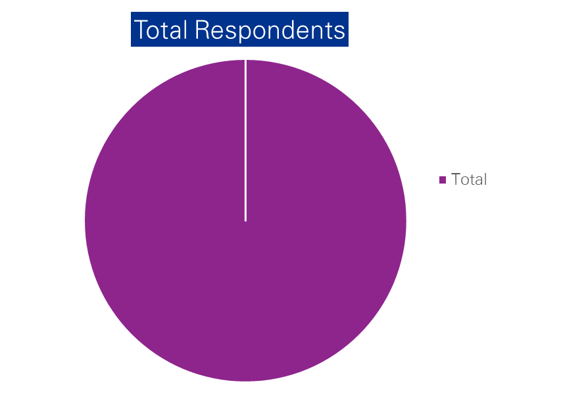
Digital Maturity Assessment – Respondents Analysis (1/4)
Co creation
The chart on the left depicts the total number of responses gathered for the Digital Maturity Assessment that was conducted for FBNQuest.
Respondents span across the following business units in FBNQuest:
Merchant Banking – 22
Asset Management - 6
Securities – 2
Trustees - 4
Alternative Investments - 4
Enabling – 14
Risk & Governance – 3
All summing to a total of 55 respondents
55
Back

Slide 66
Digital Maturity Assessment – Respondents Analysis (2/4)
Co creation
1
2
The above chart shows the participation spread across various business entities for the Digital Maturity Assessment across all work streams in scope of the digital strategy.
The above chart shows the spread of participation firm wide across the various work streams for the Digital Maturity Assessment
*Enabling – Information Technology, Human Resources, Corporate Communication & Marketing, Operations and General Services
**Risk & Governance – Strategy, Risk, Compliance, FINCON, Legal and Audit
Back

Slide 67
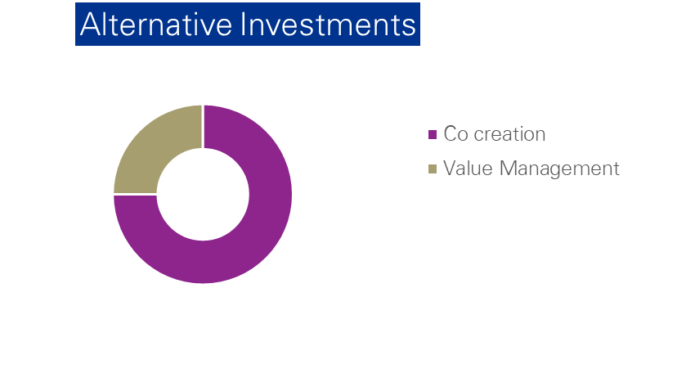
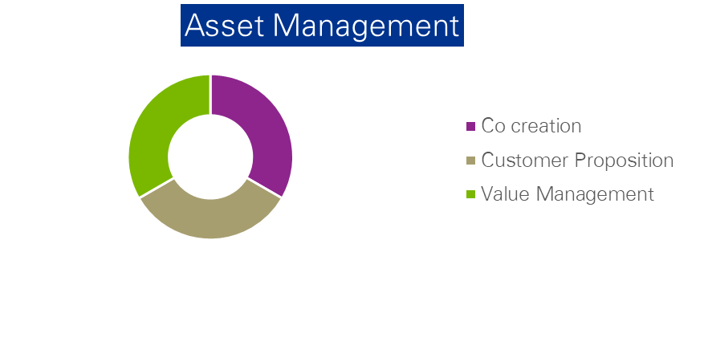
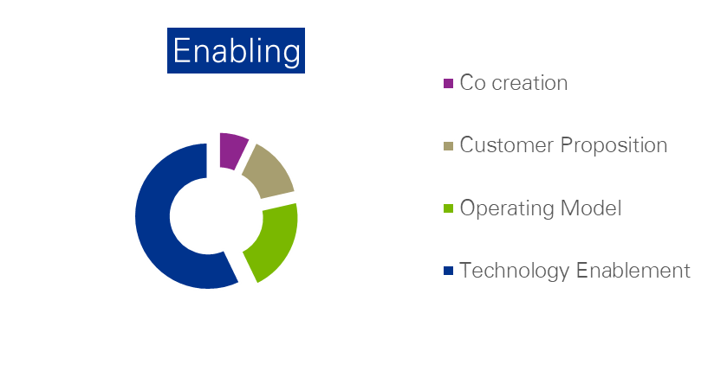
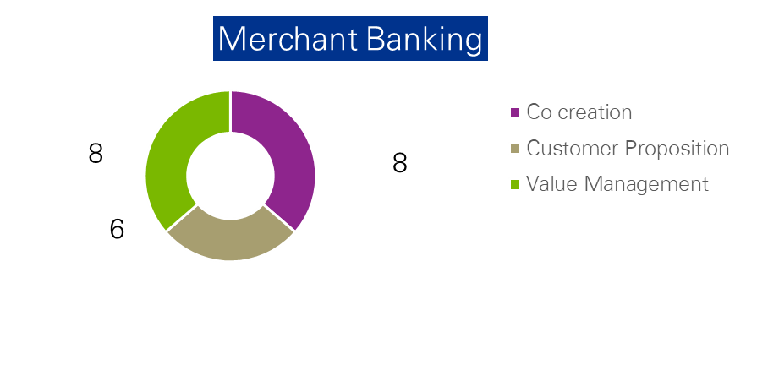
Digital Maturity Assessment – Respondents Analysis (3/4)
Co creation
1
2
2
2
1
3
2
The above chart shows participation for Alternative Investments resources across the various Digital maturity Assessment work streams
The above chart shows participation for Asset Management resources across the various Digital maturity Assessment work streams
3
4
1
2
8
3
The above chart shows participation for Enabling resources across the various Digital maturity Assessment work streams
The above chart shows participation for Merchant Banking resources across the various Digital maturity Assessment work streams
Back

Slide 68
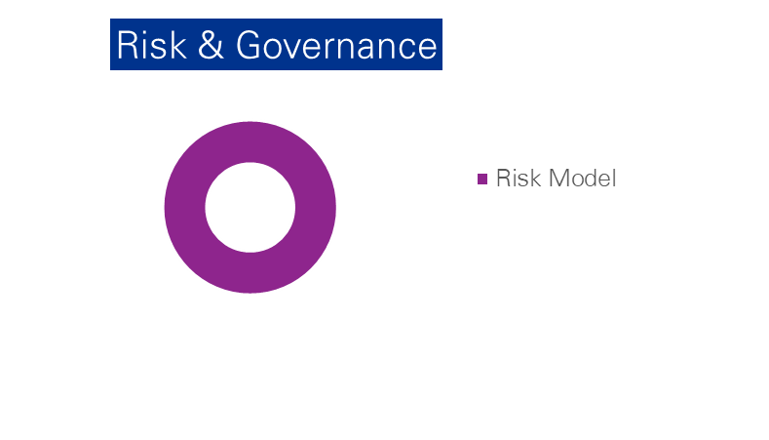
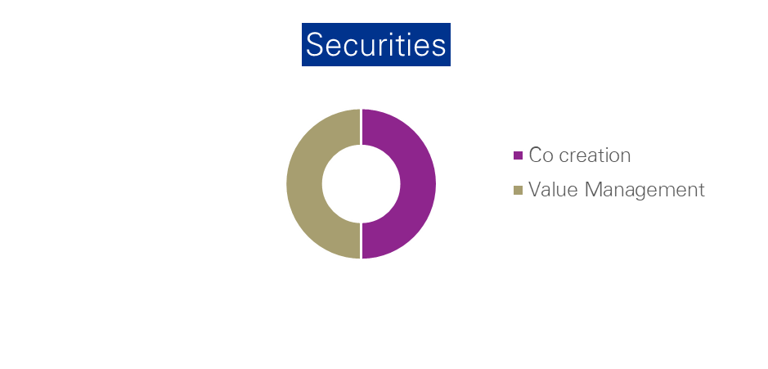
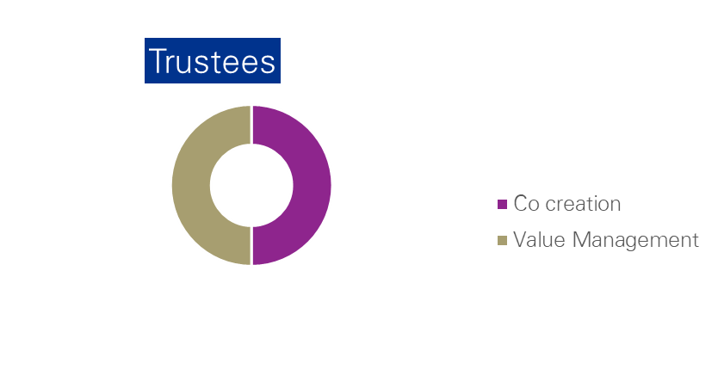
Digital Maturity Assessment – Respondents Analysis (4/4)
Co creation
1
3
3
The above chart shows participation for Risk & Governance resources for the Risk Model work stream for Digital maturity Assessment
1
1
2
2
The above chart shows participation Securities resources across the various Digital maturity Assessment work streams.
2
The above chart shows participation for Trustees resources across the various Digital maturity Assessment work streams
Back

Slide 69
Appendix
II. Detailed Weighting & Scoring Approach
Back
Notes:
Change colours
Ecosystem scanning
CRM

Slide 70
Detailed Weighting Approach
*Score/ total Score per across domains x 100
Co creation
**Score/ total Score per domain x 100
Impact
Impact
Weight*
~10%
~30%
~10%
~20%
~20%
~10%
Very High | High | Medium | Low | Very Low | Domain | Maturity Index | Very Low | Low | Medium | High | Very High
 |  |  | 2 |  | Value Management | Leadership ambition and strategy |  |  |  |  | 5
 |  |  |  |  |  | Digital KPIs and value realisation |  |  |  | 4
5 |  |  |  |  | Customer Experience Mgt. | Utilisation of customer insight to drive customer satisfaction |  |  |  |  | 5
 |  |  |  |  |  | Customer experience feedback and measurement |  |  |  | 4
 |  |  |  |  |  | Data-driven digital marketing |  |  |  | 4
 |  |  |  |  |  | Use of digital channels |  |  |  | 4
 |  |  | 2 |  | Operating Model | Establishment of robust digital governance model |  |  |  |  | 5
 |  |  |  |  |  | Digital workforce |  |  | 3
 |  |  |  |  |  | Digitisation of key operational processes |  |  |  |  | 5
 |  | 3 |  |  | Technology Enablement | API implementation and management |  |  |  |  | 5
 |  |  |  |  |  | Scalable cloud service models |  |  |  | 4
 |  |  |  |  |  | Optimal utilization of data & analytics and artificial intelligence |  |  |  | 4
 |  |  |  |  |  | Application of best practice user experience (UX) standards |  |  |  | 4
 |  | 3 |  |  | Co-creation | Establishment of Innovation Strategy |  |  |  |  | 5
 |  |  |  |  |  | Mature internal innovation sourcing processes and platforms |  |  | 3
 |  |  |  |  |  | Measured and value-driven digital partnerships & collaborations |  |  | 3
 |  |  | 2 |  | Risk Model | Risk Governance |  |  |  |  | 5
 |  |  |  |  |  | Risk Monitoring |  |  |  | 4
 |  |  |  |  |  | Risk definition & ownership |  |  | 3
 |  |  |  |  |  | Cybersecurity |  |  |  |  | 5
Weight**
56%
44%
28%
24%
24%
24%
38%
24%
38%
28%
24%
24%
24%
46%
27%
27%
29%
24%
18%
29%
Back

Slide 71
Detailed Scoring Approach
Co creation
Back

Slide 72
Appendix
III. Value Management
Notes:
Change colours
Ecosystem scanning
CRM

Slide 73
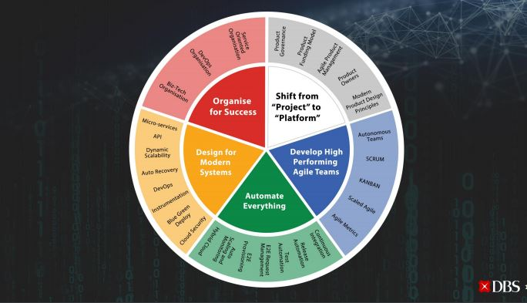
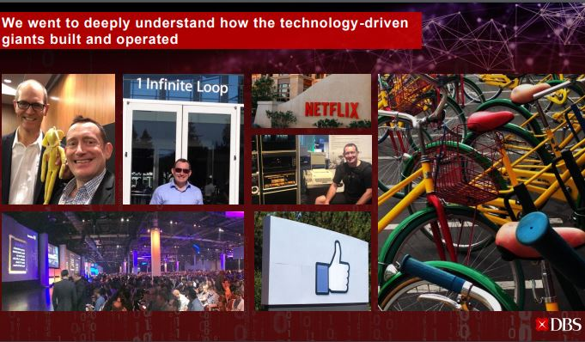
Value Management– Appendix – Leadership Ambition & Strategy
Co creation
DBS embarked on a strategy of five-key elements to drive change within the organisation
Back

Slide 74

Value Management– Appendix – Leadership Ambition & Strategy
Co creation
Lloyds puts digital banking at the heart of its three-year strategy
Transform the group into a digitized, simple, low-risk, customer-focused, financial services provider
Leverage multi-brand and multi-channel model to be the best bank for its customers
Invest more than £3 billion in strategic initiatives, an increase of more than 40 percent on its previous strategy
Back

Slide 75
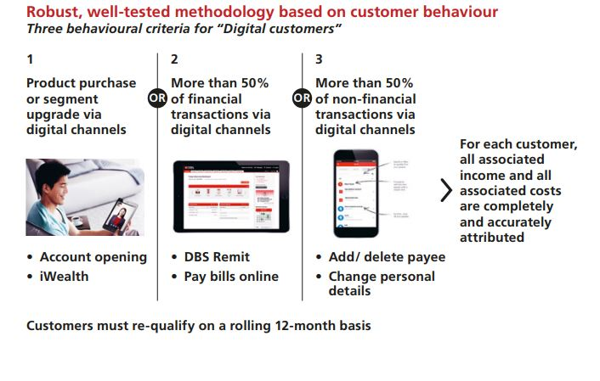
Value Management– Appendix – KPI and Value Realisation
Co creation
An organisation that has a clearly articulated key performance measures for digital initiatives
DBS’ KPIs for digital customers
Back

Slide 76
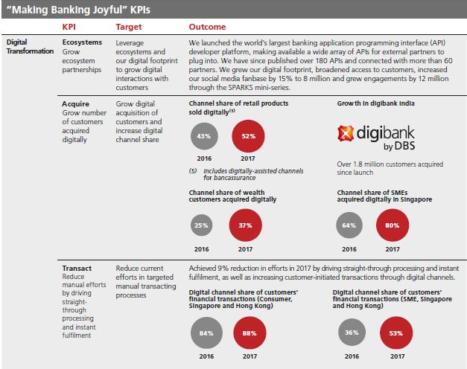
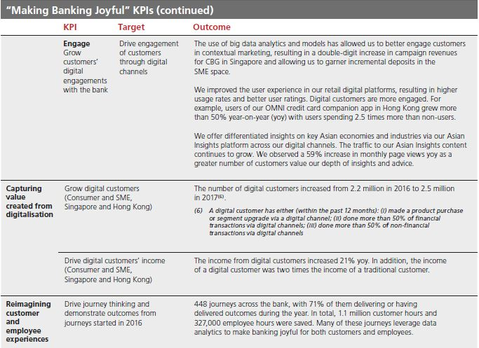
Value Management– Appendix – KPI and Value Realisation
Co creation
Back

Slide 77
Appendix
IV. Customer Experience Mgt.
Notes:
Change colours
Ecosystem scanning
CRM

Slide 78
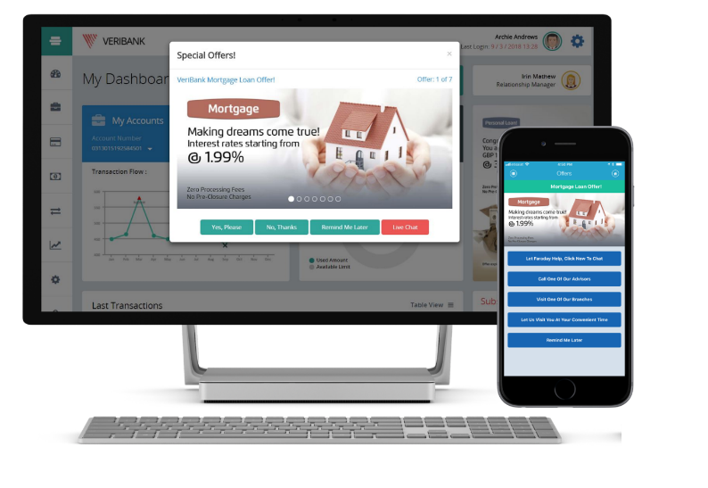
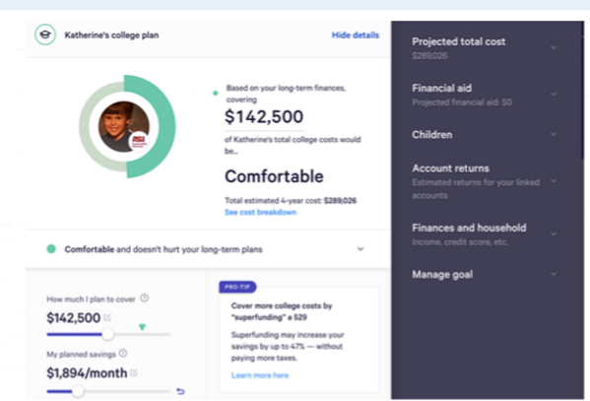
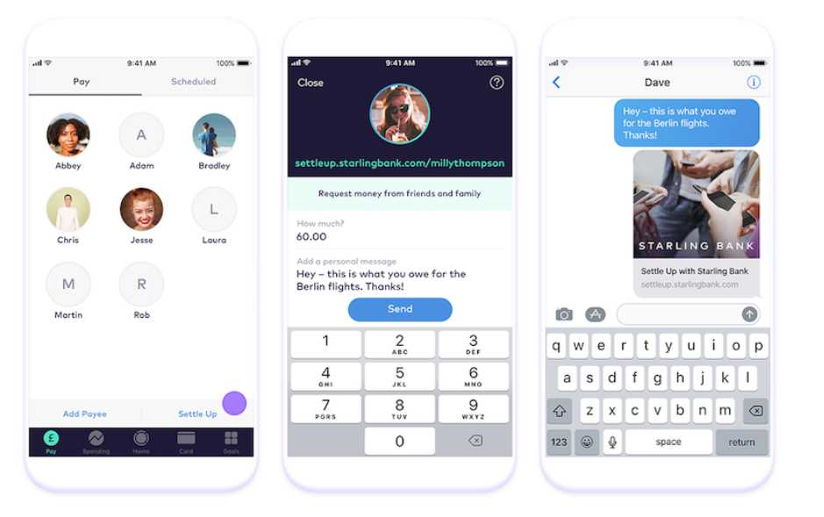
Utilizing customer data, companies have developed digital platforms to provide customized investment advice to customers
VIRTUAL ASSISTANT
ROBO-ADVISORY SERVICES
SELF-SERVICE TOOL
JP Morgan has integrated Amazon’s Voice-recognition artificial intelligence, Alexa, which specialises in providing access to analyst reports and stock information for investment banking clients. Clients are able to get information on the bank’s research reports and even financial assets price data.
Wealthfront’s automated investment service combines proven investment strategies with software to maximize client returns by providing live customer support. It also provides resource centers and blogs that offer insights to understand customer financial future
Goldmann Sachs utilizes machine learning and artificial intelligence tools to reduce turnaround time of enquiries and encourage self-service using its application, StrategyStudio, which allows clients monitor and manage their portfolios on a day to day basis and reduces the need to communicate regularly with investment managers
Back

Slide 79
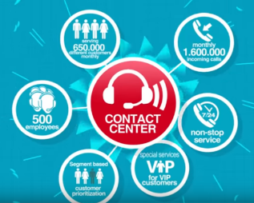

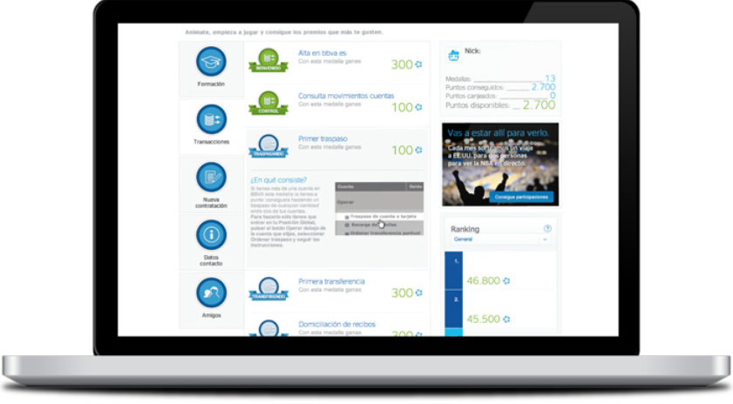
Companies have utilized analytics to predict customer behaviour and deliver quality service
Co creation
INTERACTIVE ANALYTICS
AI POWERED VIRTUAL ASSISTANT
AI ENABLED DIGITAL MARKETING
DBS deployed the analytics-based solution, NICE, to improve customer satisfaction and operational efficiency by providing comprehensive analysis of customer interactions and highlighting areas for improvement.
With NICE’s analytics technology, DBS can effectively identify the type of calls that require longer handling time - whether these relate to products or services. The bank then uses this information to determine the underlying causes of complaints, such as unclear communications, process issues, or agent knowledge gaps and utilizes the information to improve customer satisfaction.
DBS in 2017, used the platform of Amazon’s cloud based virtual assistant to create an in-app virtual assistant that answers questions and resolves complaints. Customers are able to converse with this assistant to get queries answered or banking transactions performed through voice or by text. It is not limited to answering basic questions as it understands natural language and has learning ability, it is able to respond in real time and can anticipate and answer 10,000 questions. It is akin to having a banker round the clock but without the wait time
Citigroup deploys AI along with customer data for its marketing to help acquire new and improved ideas for reaching out to current and potential clients. It integrates part of Youtube’s software called “Director Mix” and customizes different versions of commercials for each individual based on several factors such as websites often visited, their current location, weather, etc., to make the commercials more relatable.
Source: Company Websites
Back

Slide 80
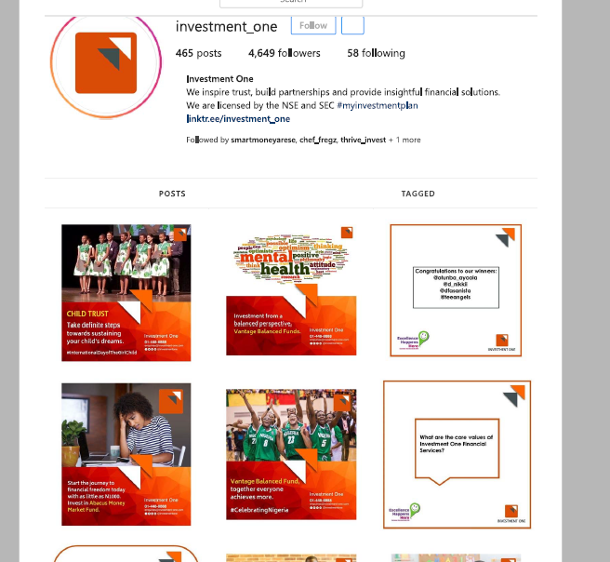

Global benchmarks are more aggressive in customer engagement via social media channels than local benchmarks
Co creation
Top 100 Banks Using Social Media, Q2 2018
Rank | Bank | Facebook Likes | Twitter Followers | Youtube Views
1 | State Bank of India | 16,725,529 | 3,391,045 | 165,337,163
2 | Wells Fargo | 1,069,315 | 283,457 | 220,965,299
3 | Yes | 7,412,846 | 3,285,435 | 83,373,274
4 | ICICI | 5,526,165 | 446,222 | 101,625,014
5 | GTBank | 5,719,449 | 1,354,508 | 12,058,388
6 | Axis | 3,692,091 | 257,314 | 66,880,294
7 | CIMB | 1,573,240 | 133,823 | 72,957,776
8 | Kotak Mahindra | 1,373,361 | 214,297 | 67,210,980
9 | HDFC | 2,701,067 | 286,597 | 48,779,636
10 | Zenith Bank | 3,862,219 | 838,625 | 13,253,841
12 | Citi | 1,196,929 | 926,992 | 27,115,516
14 | Goldmann Sachs | 193,455 | 690,645 | 40,797,486
28 | DBS | 850,097 | 22,775 | 21,967,513
57 | Stanbic IBTC | 508,263 | 219,670 | 4,144,920
68%
of the past 100 posts are product related
52%
of the past 100 posts are product related
Source: The Financial Brand Q2 2018 Top 100 Banks Using Social Media, Instagram
Back

Slide 81

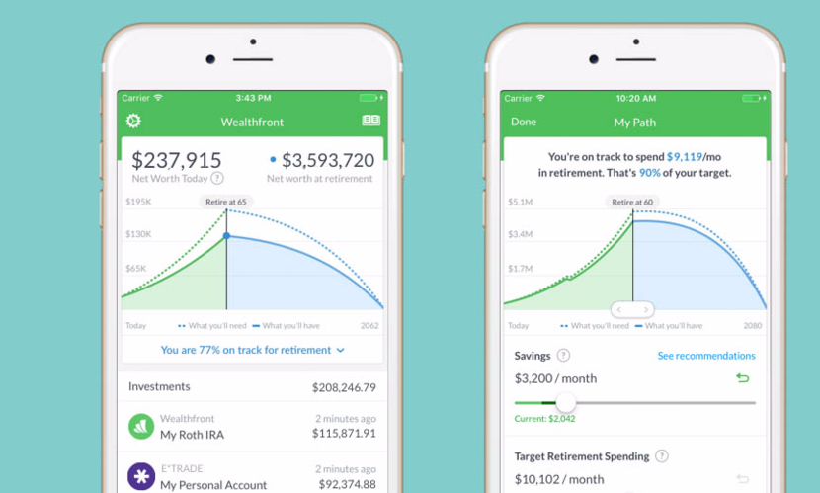
Global companies have succeeded in delivering seamless omnichannel experiences which has improved customer acquisition
Co creation
OMNICHANNEL PLATFORMS
SEAMLESS CUSTOMER EXPERIENCE
CitiDirect BE, Citigroup’s strategic omni-channel digital platform that includes mobile and tablet banking, provides direct access to all corporate online banking product and services and allows customers initiate, authorize, analyze and monitor transactions across all their accounts.
DBS introduced a comprehensive mobile banking suite, DBS iWealth, that allows customers conduct trading, gain personalised insights, take action to invest and seize opportunities, and meet their lifestyle needs while on the move.
Source: Company Websites, Financials
Back

Slide 82
Appendix
V. Digital Channels Review
Back
Notes:
Change colours
Ecosystem scanning
CRM

Slide 83


FBNQuest Digital Channels Review – Wealth Management Capabilities
FBNQuest internet and mobile banking channels have limited functionalities for optimal self-service capabilities for the wealth management business.
Business Cluster | Category | High level Features | Channel Applications
Wealth Management | Online Trading and investment | Investment Subscription
 |  | Investment Redemption
 |  | Portfolio Analysis
 |  | Portfolio Cash Forecast
 |  | Chart & Analysis
 |  | Confirmation of Investment
 | Online portfolio investments | Forex transfer service
 |  | Forex trading service
 |  | Stock trading
 |  | Market Data
 |  | Bond Trading
 | Customer Onboarding, Account Management, personalization and notifications | New Customer Registration
 |  | Account Summary
 |  | Balance Enquiry
 |  | Transaction History
 |  | Transaction and activity alerts
 |  | Token/PIN/Password Management
 |  | Bio Data Update
 | Accessibility | Help and Support
Web App
Mobile
Availability
Fully Available
Minor Improvements
Limited
None
N/A
Back

Slide 84
FBNQuest Digital Channels Review – Corporate Banking Capabilities
FBNQuest internet channel has limited functionalities for optimal self-service capabilities for the corporate banking business. No mobile capabilities.
Business Cluster | Category | High level Features | Channel Applications
Corporate Banking | Payments & Transfers | Bulk Payments
 |  | Single Payments
 |  | Local Funds Transfer
 |  | International Funds Transfer
 |  | Beneficiary Management
 |  | Recurring Payments
 | Lending | Corporate Loans
 | Trade Finance | Letters Of Credit
 |  | Bill collection and invoice factoring service request
 | Employer Services | Payroll Planning Service request
 |  | Group Retirement Plan service request
 | Customer Onboarding, Account Management, personalization and notifications | Account Opening
 |  | Account Summary
 |  | Balance Enquiry
 |  | Transaction History
 |  | Transaction and activity alerts
 |  | Token/PIN/Password Management
 |  | Bio Data Update
 | Accessibility | Help and Support
Web App
Mobile
Availability
Fully Available
Minor Improvements
Limited
None
N/A
Back

Slide 85






FBNQuest Mobile Channel Benchmarking – Wealth Management Capabilities
FBNQuest’s mobile channel self-service capabilities for wealth management is not competitive in comparison with local and global benchmarks.
Wealth Management |  | Local Competition |  |  | Global Competition
Features
Investment Subscription
Investment Redemption
Confirmation of Investment
Forex transfer service
Forex trading service
Stock trading
Market Data
Portfolio Analysis
Portfolio Cash forecast
Bond Trading
New Customer Registration
Account Summary
Balance Enquiry
Transaction History
Transaction and activity alerts
Token/PIN/Password Management
Bio Data Update
Help and Support
✔
✔
✔
✔
✔
✔
✔
✔
✔
X
✔
✔
X
X
✔
X
✔
✔
X
✔
✔
X
X
✔
X
X
✔
X
X
✔
✔
✔
✔
✔
✔
✔
✔
✔
✔
✔
✔
✔
X
✔
✔
✔
✔
✔
✔
✔
✔
X
✔
✔
Availability
✔
Available
X
Not Available
Back

Slide 86

FBNQuest Mobile Channel Benchmarking – Corporate Banking Capabilities
FBNQuest’s mobile channel self-service capabilities for corporate banking is not competitive in comparison with global benchmarks.
Corporate Banking |  | Local Competition |  |  | Global Competition
Features
Bulk Payments
Single Payments
Local Funds Transfer
International Funds Transfer
Beneficiary Management
Recurring Payments
Corporate Loans
Letters Of Credit
Bill collection and invoice factoring service request
Payroll Planning Service request
Group Retirement Plan service request
Account Opening
Account Summary
Balance Enquiry
Transaction History
Transaction and activity alerts
Token/PIN/Password Management
Bio Data Update
Help and Support
X
X
✔
X
X
✔
X
X
✔
X
X
✔
X
X
✔
X
X
✔
X
X
X
X
X
X
X
X
X
X
X
X
X
X
X
X
X
✔
X
X
✔
X
X
✔
X
X
✔
X
X
✔
X
X
✔
X
X
✔
X
X
✔
Availability
✔
Available
X
Not Available
Back

Slide 87
FBNQuest Internet Banking Channel Benchmarking – Wealth Management Capabilities
FBNQuest’s internet banking self-service capabilities for wealth management is not competitive in comparison with local and global benchmarks.
Wealth Management |  | Local Competition |  |  | Global Competition
Features
Investment Subscription
Investment Redemption
Confirmation of Investment
Forex transfer service
Forex trading service
Stock trading
Market Data
Portfolio Analysis
Portfolio Cash forecast
Bond Trading
New Customer Registration
Account Summary
Balance Enquiry
Transaction History
Transaction and activity alerts
Token/PIN/Password Management
Bio Data Update
Help and Support
X
✔
✔
X
✔
✔
X
✔
✔
X
✔
✔
X
X
✔
X
✔
✔
X
✔
✔
X
✔
✔
X
✔
✔
X
X
✔
X
✔
✔
✔
✔
✔
✔
✔
✔
✔
✔
✔
X
✔
✔
✔
✔
✔
✔
✔
✔
X
✔
✔
Availability
✔
Available
X
Not Available
Back

Slide 88
FBNQuest Internet Banking Channel Benchmarking – Corporate Banking Capabilities
FBNQuest’s internet banking self-service capabilities for corporate banking is not competitive in comparison with local and global benchmarks.
Corporate Banking |  | Local Competition |  |  | Global Competition
Features
Bulk Payments
Single Payments
Local Funds Transfer
International Funds Transfer
Beneficiary Management
Recurring Payments
Corporate Loans
Letters Of Credit
Bill collection and invoice factoring service request
Payroll Planning Service request
Group Retirement Plan service request
Account Opening
Account Summary
Balance Enquiry
Transaction History
Transaction and activity alerts
Token/PIN/Password Management
Bio Data Update
Help and Support
X
✔
✔
X
✔
✔
X
✔
✔
X
✔
✔
X
✔
✔
X
X
✔
X
X
✔
X
X
✔
X
X
X
X
X
X
X
X
X
X
✔
✔
✔
✔
✔
✔
✔
✔
✔
✔
✔
X
X
✔
✔
✔
✔
X
✔
✔
X
✔
✔
Availability
✔
Available
X
Not Available
Back

Slide 89
Appendix
VI. Operating Model
Notes:
Change colours
Ecosystem scanning
CRM

Slide 90




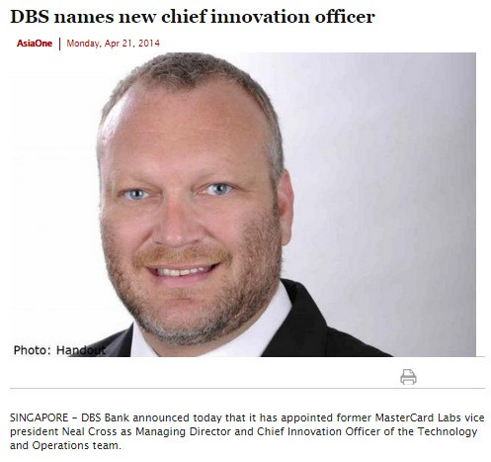
Operating Model – Supporting Details
Co creation
Elevated the role of innovation with new Chief Innovation Officer appointment
(Mr Neal Cross)
Back

Slide 91





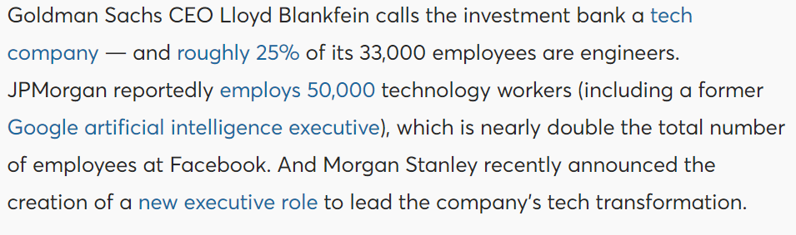
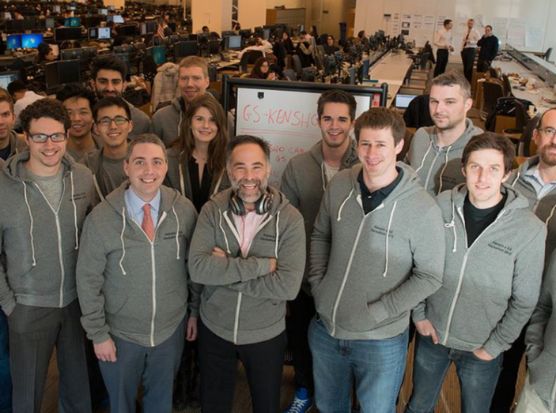
Operating Model – Supporting Details
Co creation
Back

Slide 92
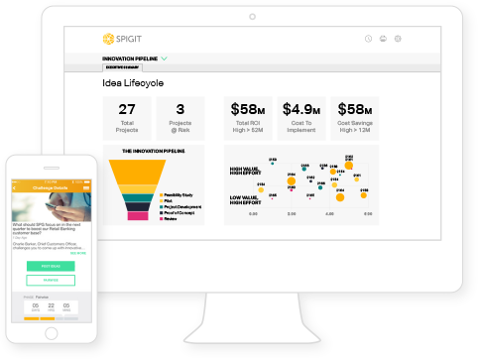
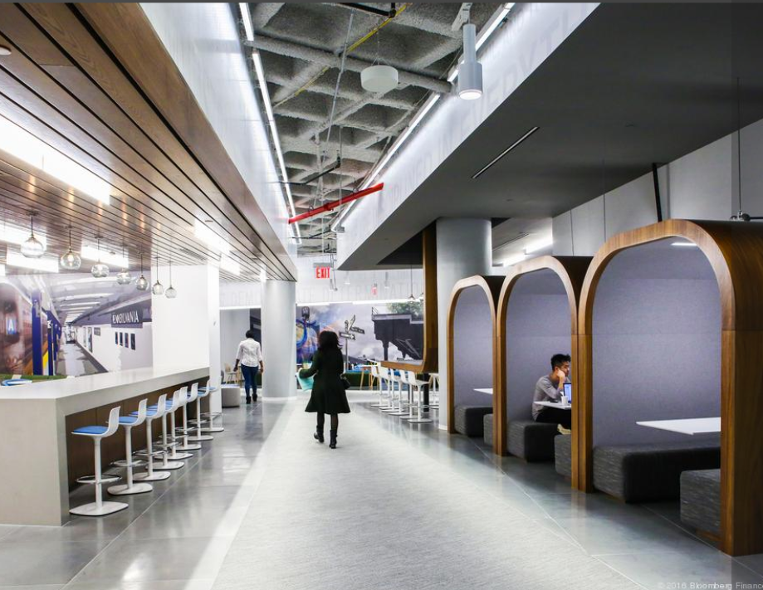




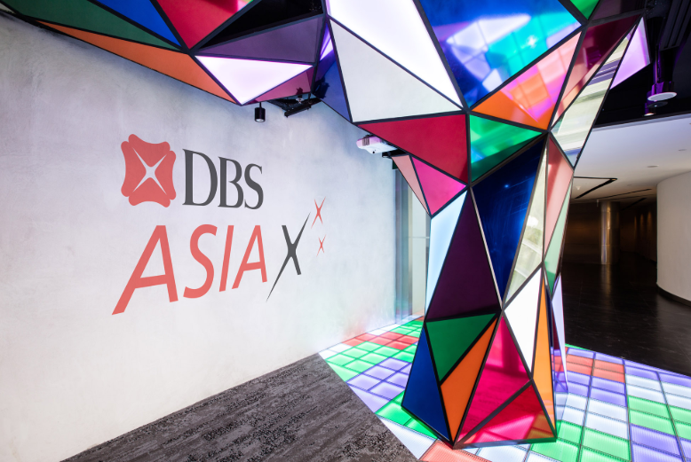
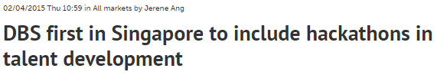
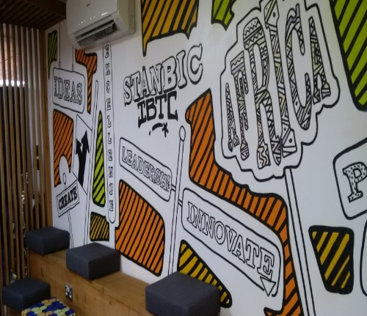


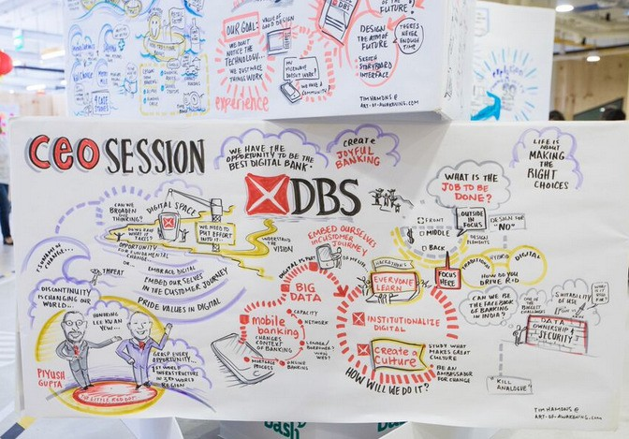
Operating Model – Supporting Details
Co creation
Citi created the “Future in Banking Challenge” on Spigit
Over 46,000 employees participated submitting more than 2,000 ideas
JP Morgan Technology Hub
4 Hackathons
250+ DBS Employees
160+ entrepreneurs
50+ prototypes co-created
…if we wish to remain relevant, our employees must embrace a culture of innovation and be intrapreneurs.
- Dave Gledhill, DBS Head of Group Technology & Operations
As the bank embarks on its digital journey, it is essential to groom the next generation of digitally-minded leaders through exposure, education and experiential learning.
- Lee Yan Hong, DBS Head of Group HR
Stanbic Blue Lab Innovation Space
DBS Innovation lab
Back

Slide 93
Appendix
VII. Technology Enablement
Notes:
Change colours
Ecosystem scanning
CRM

Slide 94


Technology Enablement – API
Co creation
Deposits
Fund Transfers
Loans
Research & Analytics
Pricing & Structuring
Execution
Parties
Rewards
Reference Data
Post-trade
Banking
Over 150+ APIs available in the above categories for DBS Bank
The above categories of open APIs are available from J.P. Morgan
Back

Slide 95



Technology Enablement – API
Co creation
Organise API hackathons for the general public and get employees involved in other external API hackathons to:
Source innovations free from any restrictions;
Boost innovation;
Discover new and better solutions to problems;
Create a more cool and current image of your company for your audience;
Push your employees to explore their creative boundaries in the lookout for the next best product.
Back

Slide 96

Technology Enablement – Cloud
Over 200,000 servers
are owned by Goldman Sachs;
90% of servers on Cloud
90%
of which are hosted on the cloud
100% virtual desktops
Back

Slide 97

Technology Enablement – Data and Analytics
Customer Data
Government Data
DBS Home Connect; a resource for home buyers
Back

Slide 98
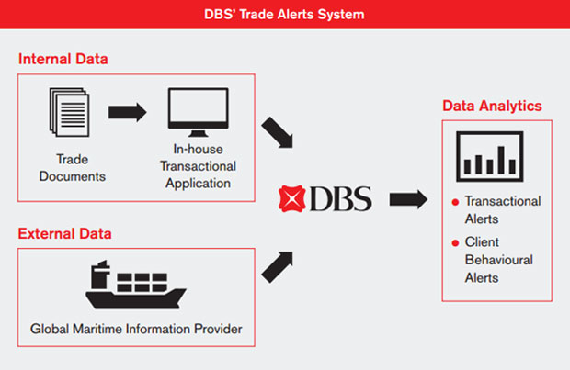
Technology Enablement – Data and Analytics
Internal data is collected in a structured format
Both the internal data and external data are collated and analysed to provide business intelligence reports
External data is collected from external sources
Back

Slide 99
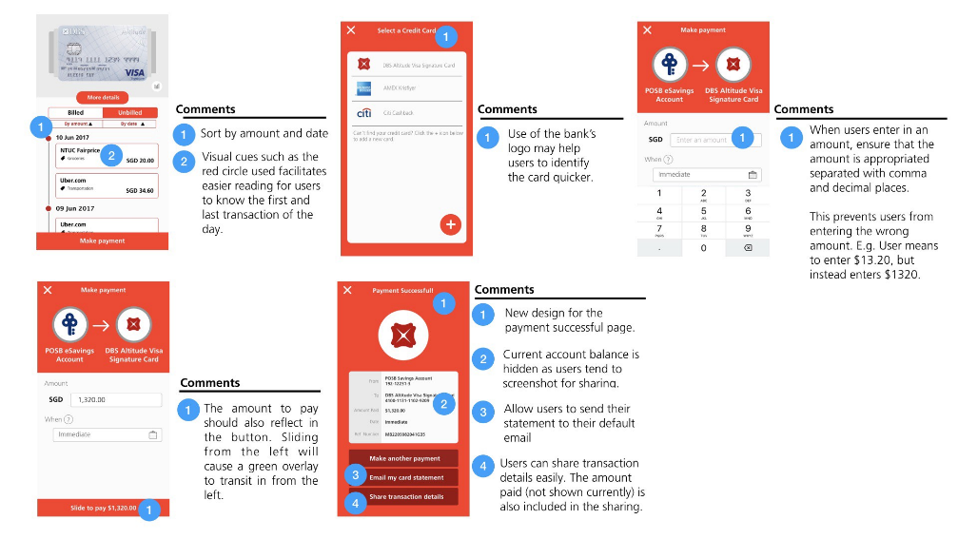
Technology Enablement – User Experience
A user experience team dedicated to research and design of great software for customers, investors and financial advisors was set up
Back

